Slide 1
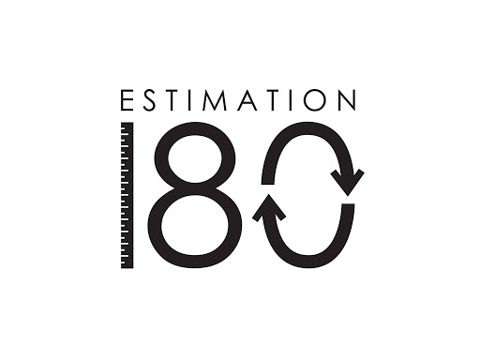
Starters
Today’s estimation.
http://www.estimation180.com/day-118.html
There are 21 marshmallows already, how many more are needed to complete the outline of the 4 leaf clover? You can be within 5.
Use Hit the Button to practise times tables and division skills.
https://www.topmarks.co.uk/maths-games/hit-the-button

Slide 2
Problems of the day

Slide 3
Answers to Problems of the Day
1
3
4
2

Slide 4
Today we will be looking at Subtracting decimals with the same number of decimal places. You will find the video in SUMMER TERM –Week 9 (w/c 22nd June). It is lesson 1.
https://whiterosemaths.com/homelearning/year-5/

