Slide 1
English Work
We call this type of work in English “responding to an illustration”. In class, the children would look closely at the details in an image, knowing that an illustrator places clues and “Easter eggs” that make reference to elements of the story to come. They then write about what they see.
Outcome: To write and edit an opening paragraph.
We can break it down into 4 steps.

Slide 2
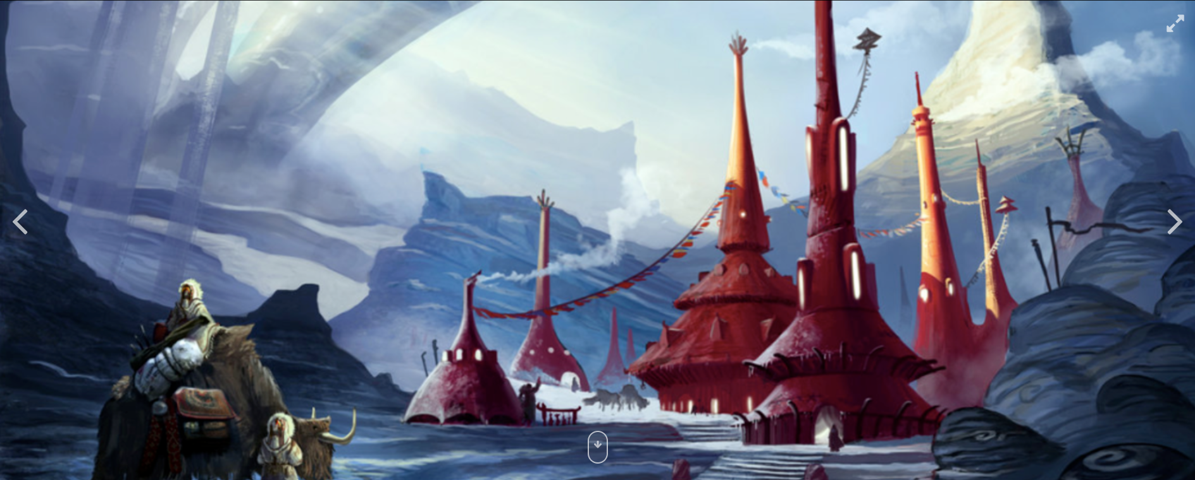
Week 1 Day 1: Identify objects and add adjectives

Slide 3
Day 1: Adjectives!

Slide 4
Week 1 Day 2: Include verbs and adverbs

Slide 5
Day 2: Verbs and Adverbs!

Slide 6
Which words would you use to describe elements of the picture? Write sentences!
ruby red nestled rising hazy reaching funnel-shaped trudging returning spires frozen contrast jagged fluttering
Week 1 Day 3: Sentence writing!

Slide 7
Day 3: Sentences!

Slide 8
Week 1 Day 4 (i): Story writing!
On Thursday, using all this preparation, we will aim to write the opening paragraph of a story or more if inspiration strikes!
Remember to use all the fantastic vocabulary you have developed up to now!

Slide 9
Day 4 (i): Write!

Slide 10
Step 4a: Success Criteria:
I have used capital letters and correct punctuation.
I have included exciting adjectives, verbs and adverbs.
I have used fronted adverbials and time connectives.
Step 4b: Edit!
Go back and check that all punctuation and capital letters have been included and key words have been spelled correctly.

Slide 11
Day 4 (ii) : Edit!

Slide 12
Week 1 Lesson 1
L.O. To respond to an illustration.

Slide 13
Day 1: Nouns and adjectives
Look at the image carefully. Make a list of things you spot in the image and include exciting adjectives in noun phrases to describe them!
A glowing, red sunset
Determiner + Adjective , + Adjective + Noun

Slide 14
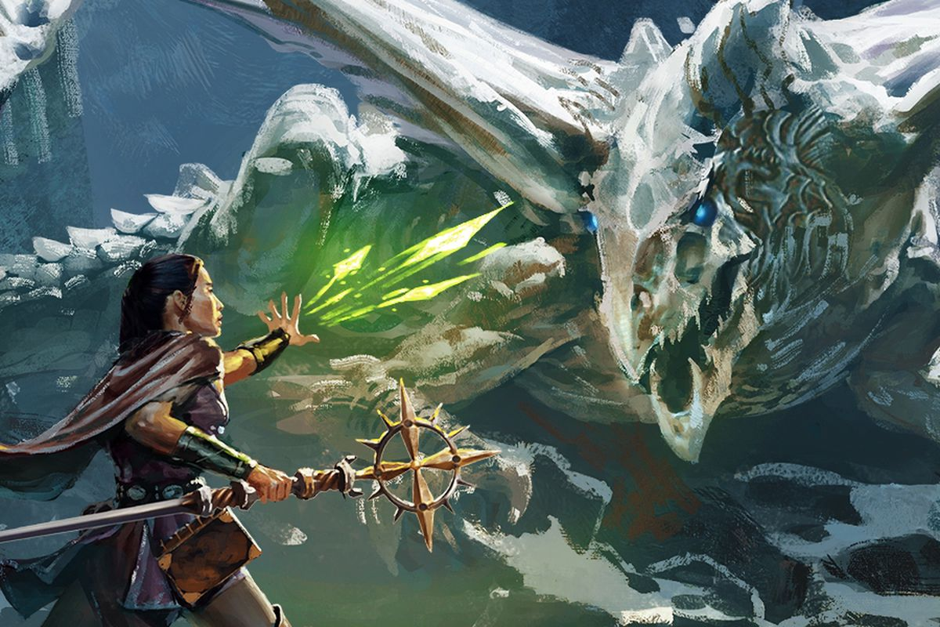
Impress me with 3 fantastic noun phrases to describe things you see in this picture! Remember! A noun phrase = adjective, adjective, adjective noun

Slide 15
Week 1 Lesson 2
L.O. To respond to an illustration.

Slide 16
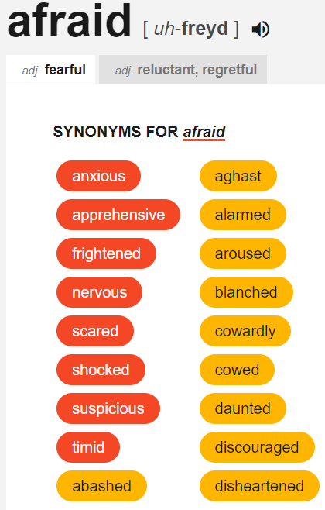
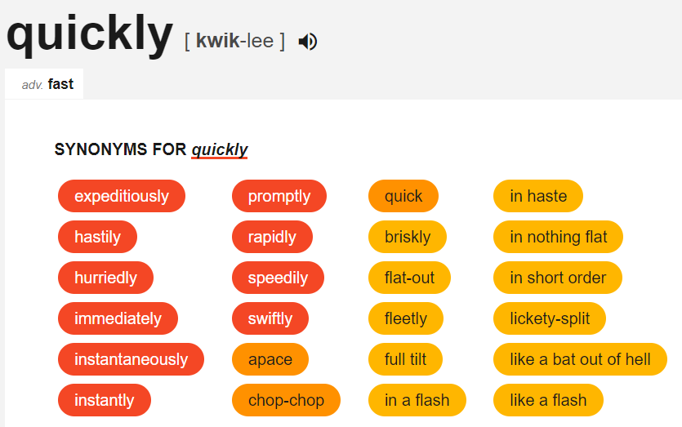
Day 2: Verbs and Adverbs
2. Look at the image carefully. Make a list of things you spot happening in the image and include exciting adverbs to describe them!
Use Thesaurus.com to broaden your vocabulary choices!

Slide 17
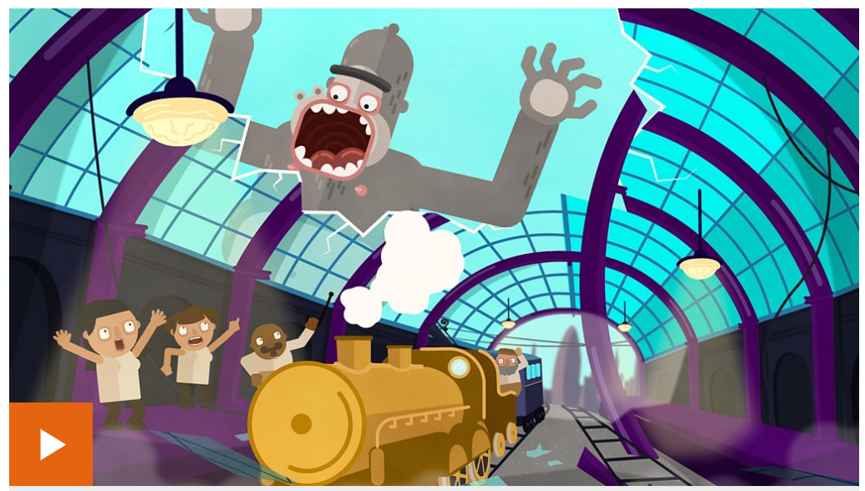
Day 2: Verbs and Adverbs
Forgotten what an adverb is?
Click on the picture below for a Bitesize recap!
Notes:
https://www.bbc.co.uk/bitesize/topics/zwwp8mn/articles/zgsgxfr

Slide 18
Impress me with 3 fantastic noun phrases to describe things you see in this picture! Remember! A noun phrase = adjective, adjective, adjective noun

Slide 19
Share your ideas with someone.
By doing this:
You’ll really impress the person you share your writing with!
b. The ideas for your story will continue to take shape.

Slide 20
Week 1 Lesson 3
L.O. To respond to an illustration.

Slide 21
Lesson 3: Writing a great sentence!
Read the words on the left of the picture. Use a dictionary to check the meaning of any you don’t understand. Decide which words are most suitable to describe elements of the illustration. Write some great sentences using these and any other words you have used so far.

Slide 22
Which words would you use to describe elements of the picture?
fossilised ancient azure glowing shrieking flinching radiating looming bravely emerald sceptre spell titan

Slide 23
Week 1 Lesson 4
L.O. To respond to an illustration.

Slide 25
Write the opening paragraph of your story!
Before you begin, read back over your work so far this week!
Remember to punctuate your work!
When finished, read it aloud to check for mistakes/improvements. Edit with your purple pen.
Don’t stop there if you’ve got more to write!

Slide 26
Read your story to someone!

Slide 27
Week 1 Lesson 5
L.O. Spelling Practice.

Slide 28
Practice your spellings. You’ll find them on our class pages under the homework tab!
Ask someone to quiz you on them!
How did you do?

