Slide 1
Water Aid
By Carrie Phillips & Amel Guemar

Slide 2
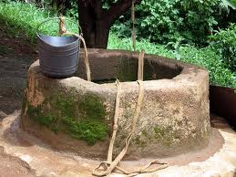
Water
Without access to safe water for drinking, cooking and cleaning.
People are most likely to suffer from water related diseases.
Over 2,000 children can die in only one day due to the lack of clean water

Slide 3
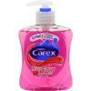
Hygiene
Where poor hygiene is practised, water-related diseases spread fast
Manure is used to grow crops as there is no other materials to use
Just using soap and washing your hands when necessary can cut down the chance of disease in half

Slide 4
Sanitation
Where there is nowhere safe and clean to go to the toilet people are exposed to disease
Improving sanitation is difficult and requires people to change their ways of living in Bangladesh

Slide 5
Fund raising
Marathons, expeditions, bake sales, concerts, choral singing – there is an endless variety of ways to raise funds!
Lots of money is raised and everyone is thankful . This money is used to produce clean wells to get water.

Slide 6
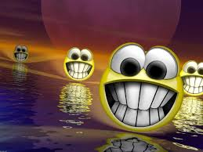
Thank you for listening we hope you liked it

