Slide 1
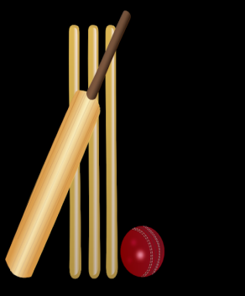
INSTRUCTIONS
WELCOME TO OUR CRICKET WEEK!
Choose your aspect of the game: fielding, throwing, bowling and batting.
Can you complete all 4 challenges within that aspect individually or with a partner?
Or you can start at Bronze challenges, then Silver and then progress to Gold or Platinum with practice and determination.

Slide 2
At Home Cricket
Bronze Challenge: Fielding
Ask a partner to roll the ball towards you or roll it yourself and chase it. Make sure you get in front of the ball
Pick up the ball between your feet with 2 hands, palms up and fingers down and together
Step forwards and throw back to your partner or throw to a target.

Slide 3
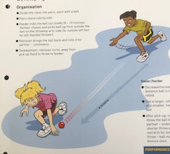
At Home Cricket
Silver Challenge: Fielding
1
2
Stand by a start marker. Roll the ball out along the ground in front of you or get a partner to roll it for you.
Chase the ball. Pick it up from outside of the foot, on your throwing side. See the picture.
4
3
Once you have picked it up can you turn quickly and throw it at your start marker?
Decrease or increase the distance the ball is to be rolled.
Can you roll it faster and still catch up with it?

Slide 4
At Home Cricket
Gold Challenge: Fielding
Pick up the ball between your feet
Cross your back foot behind your front foot to establish a strong throwing position
Front foot steps forward and into the throw.
1
2
3
How fast can you complete all three steps?
How far can you throw the ball?

Slide 5
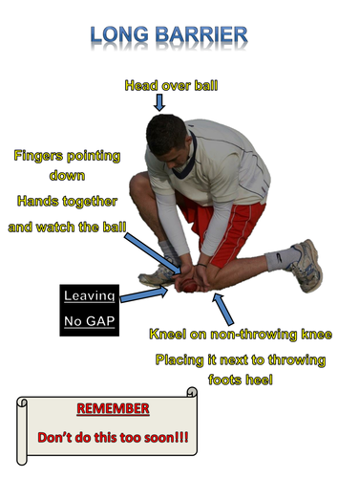
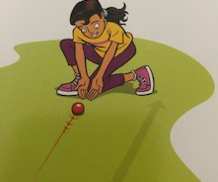
At Home Cricket
Platinum Challenge: Fielding
1
Partner: Can you roll the ball faster or from further away?
Can you roll it to the R and L of the player?
GET BEHIND THE BALL
Ask someone to roll a ball towards you.
GET DOWN TO THE BALL
If you miss the ball with your hands, your body will stop it.
COLLECT THE BALL
Stand up and throw back to your partner.
Repeat.
Don’t let any balls go past you!
3
2

