Slide 1
Week 2 Lesson 1
L.O. To identify and use pronouns

Slide 2
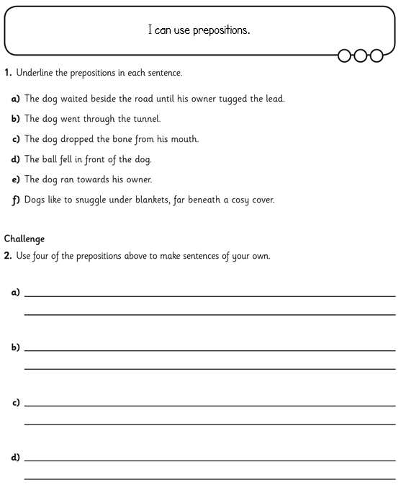
Preposition lesson
Preposition Song
Worksheet
Click the links below for the video, song and worksheet!

Slide 3
Week 2 Lesson 2
L.O. To identify and use subordinating conjunctions.

Slide 4
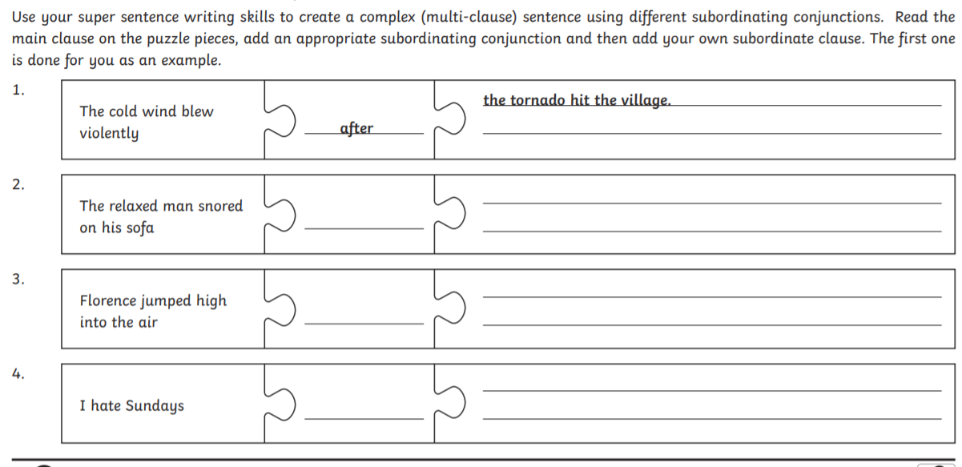
Subordinating conjunctions video
Worksheet
Poster
Click the links below for the video, song and worksheet!

Slide 5
Week 2 Lesson 3
L.O. To identify and use coordinating conjunctions.

Slide 6
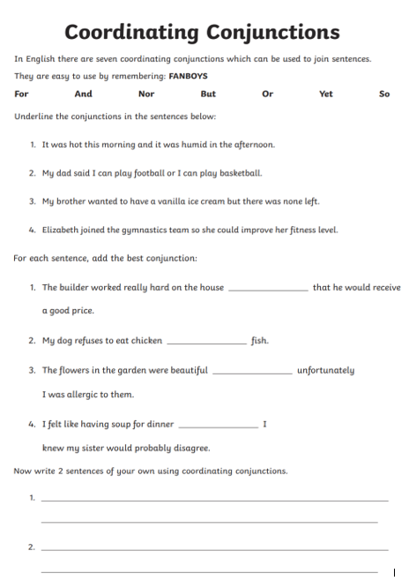
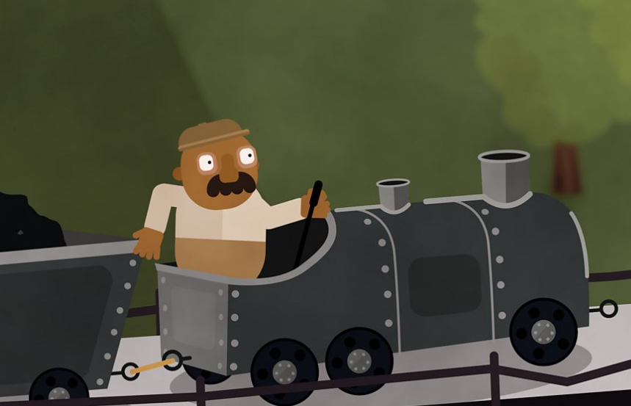
Coordinating conjunctions video
Worksheet
Click the links below for the video, song and worksheet!

Slide 7
Week 2 Lesson 4
L.O. To identify and use adverbs.

Slide 8
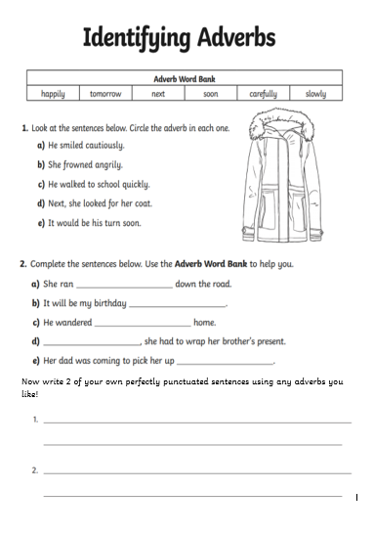
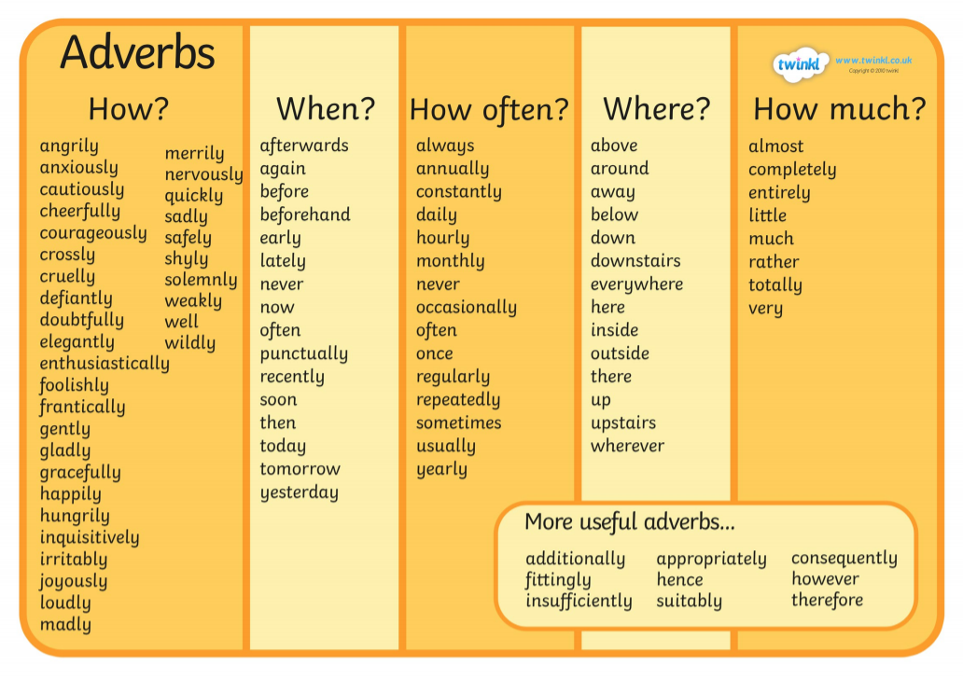
Adverbs video
Adverb-Word-Mat.pdf
Adverbs Worksheet.pdf
Click the links below for the video, song and worksheet!

Slide 9
Week 2 Lesson 5
L.O. Spelling Practice and Quiz.

Slide 10
Practice your spellings. You’ll find them on our class pages under the homework tab!
Ask someone to quiz you on them!
How did you do?

