Slide 2
1) Complete the missing numbers.
2) Complete the number track.
3) 1,000 $÷$ 10 $=$
4) 10,000 $÷$ 10 $=$
1,000
2,000
3,000
5,000
2,000
4,000
10,000

Slide 3
1) Complete the missing numbers.
2) Complete the number track.
3) 1,000 $÷$ 10 $=$
4) 10,000 $÷$ 10 $=$
1,000
2,000
3,000
4,000
5,000
6,000
2,000
4,000
6,000
8,000
10,000
100
1,000

Slide 4
Complete the number line.
1,000
0
100
200
300
400
500
600
700
800
900
1,000
1,000 $÷$ 10 $=$
100

Slide 5
Complete the number line.
10,000
0
1,000
2,000
3,000
4,000
5,000
6,000
7,000
8,000
9,000
10,000
10,000 $÷$ 10 $=$
1,000

Slide 6
Place 2,500 on the number line.
2,500
0
2,000
3,000
10,000
The previous multiple of 1,000 is 2,000
500 is half of 1,000
The next multiple of 1,000 is 3,000
2,500 is halfway between 2,000 and 3,000

Slide 7
Place 3,620 on the number line.
3,620
1,000
3,000
3,600
3,700
4,000
The previous multiple of 100 is 3,600
3,620 is closer to 3,600 than 3,700
1,000 $÷$ 10 $=$
100
The next multiple of 100 is 3,700

Slide 8
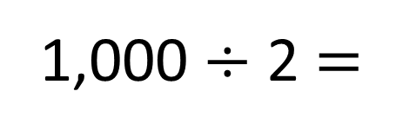
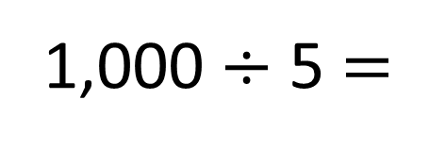
1,000
3,000
3,200
3,400
3,600
3,800
4,000
1,000 $÷$ 5 $=$
200
1,000
3,000
3,500
4,000
1,000 $÷$ 2 $=$
500

Slide 9
Have a think
Estimate the values of A and B.
A
B
0
2,500
5,000
7,500
10,000
A is approximately 2,000
B is approximately 7,520

