Slide 2
Thursday 17th September 2020
LO: To look at the position of a 2 and 3 digit number on a number line.
Success Criteria:
I can understand the importance of the number 5
I can use that knowledge to round up or down

Slide 3
1) 10, 20, ___, 40, 50, 60, ___ , ___
2) ___, 350, 360, 370, 380, ___, ___
3) 4 $+$ ___ $=$ 10
4) __ $+$ 8 $=$ 10

Slide 4
1) 10, 20, ___, 40, 50, 60, ___ , ___
2) ___, 350, 360, 370, 380, ___, ___
3) 4 $+$ ___ $=$ 10
4) __ $+$ 8 $=$ 10
30
70
80
340
390
400
6
2

Slide 5
Round 73 to the nearest 10
10
70
71
72
73
74
75
76
77
78
79
80

Slide 6
Round 73 to the nearest 10
3
7
70
71
72
73
74
75
76
77
78
79
80
73 is closer to 70 than 80
73 rounded to the nearest 10 is 70

Slide 7
Round 78 to the nearest 10
8
2
70
71
72
73
74
75
76
77
78
79
80
78 is closer to 80 than 70
78 rounded to the nearest 10 is 80

Slide 8
Round 35 to the nearest 10
5
5
30
31
32
33
34
35
36
37
38
39
40
35 rounded to the nearest 10 is 40

Slide 9
Round 144 to the nearest 10
4
6
140
141
142
143
144
145
146
147
148
149
150
144 is closer to 140 than 150
144 rounded to the nearest 10 is 140

Slide 10
Which numbers round to 240 to the nearest 10?
235
236
237
238
239
240
241
242
243
244
245
5
6
7
8
9
1
2
3
4
What patterns do you notice when rounding to 10?

Slide 11
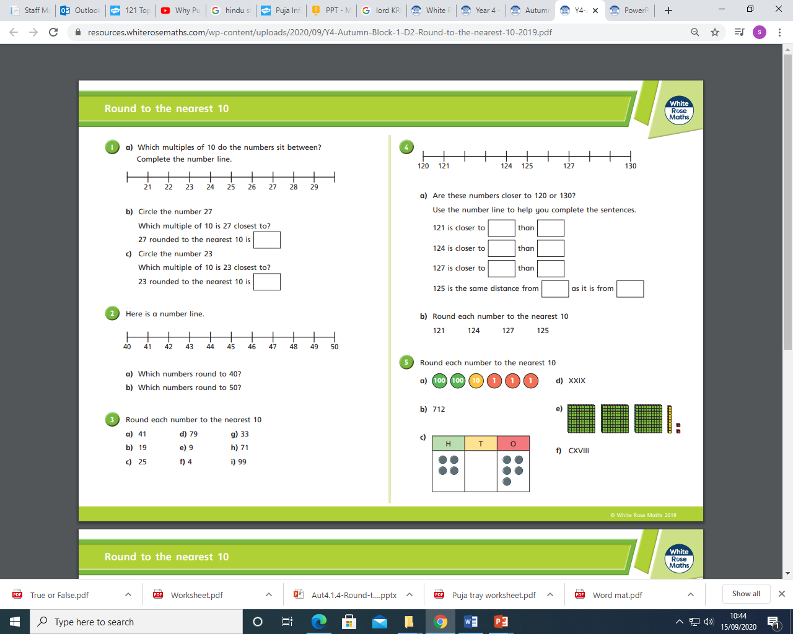
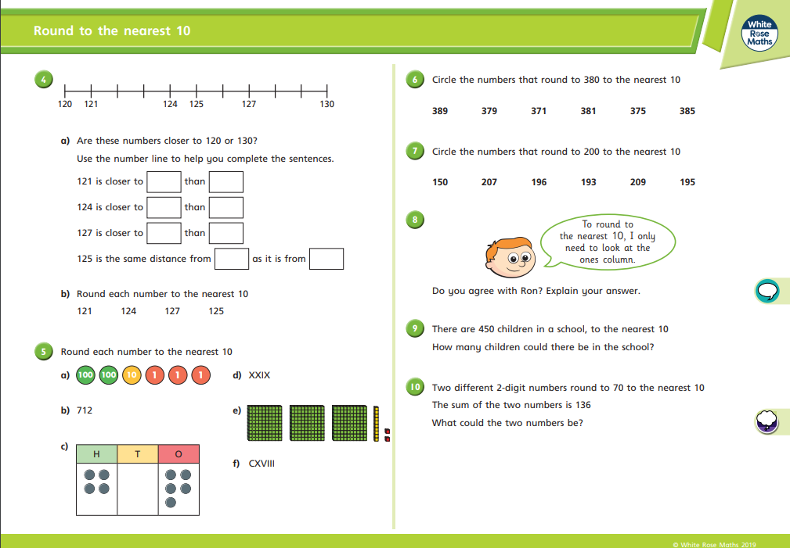
Main task
Extension

