Slide 1
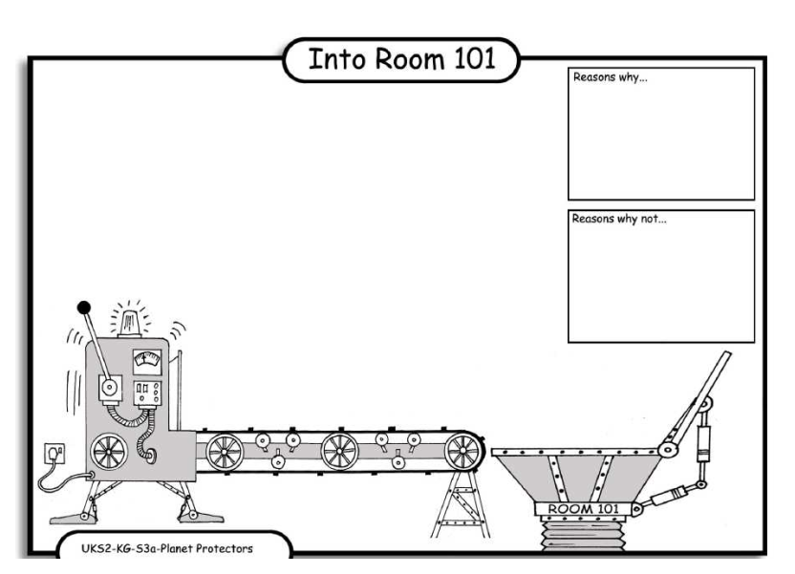
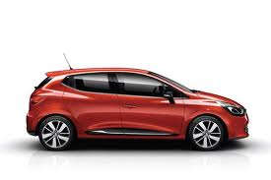
LO: Debating. 4.10.2013 Sky and Victoria
Reasons why:
If you use your car a lot it will waste petrol then there will be no left.
Reasons why :
Stop using A car because it makes the air smell.
Reasons why:
If there was no cars people will be fit by walking.
Reasons why:
When you use your car a lot it will turn old and rustey.

