Slide 1
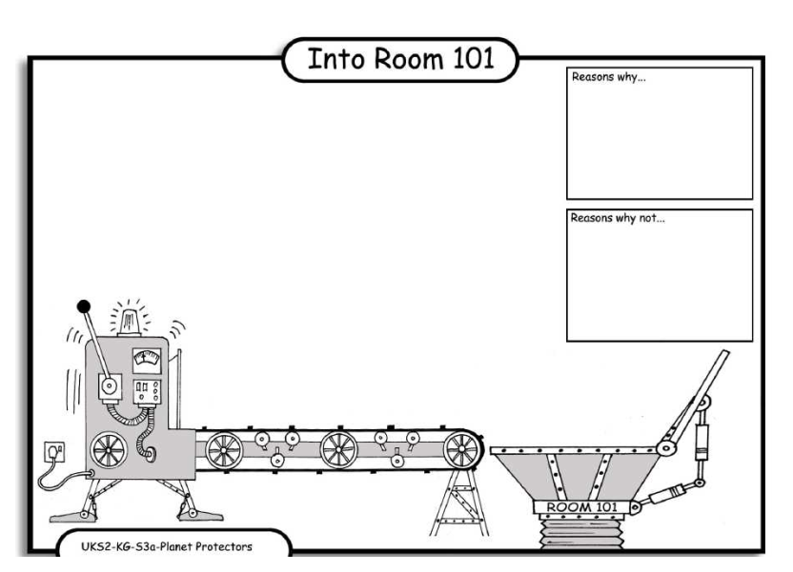
LO: Debating. 4.10.2013 Dean and Raya
Reasons why;
Sometimes they crash into other airaplans and people die.
Reasons why:
If there were no airaplans the world would be a helfeaer place.
Reasons why:
The reason why we don’t like airplanes is because the fuel makes the air dirty and the ice melts.
Reasons why:
Instead of yousing airaplans you can yous boats.

