Slide 1
THE CAUTIONARY TALES OF
Hilaire Belloc
Notes:
http://www.archive.org/stream/cautionarytalesf00belluoft#page/n5/mode/2up (online copy).

Slide 2
Monday 31st January 2022 LO: To prepare and present a point of view
I can:
Compare two similar poems.
Analyse a cautionary tale from a particular point of view.
Justify my point of view.

Slide 3
How many words can you find? Can you find the nine-letter word? You can only use each letter once, unless it appears twice.
twice.

Slide 4
Monday 31st January 2022 LO: Prepare and present a point of view
This week, we are focusing on the Cautionary Tales of Hilaire Belloc (1907).
You will be thinking about the purpose of the poems and how this has determined the language choices.
What do you think 'cautionary' might mean?

Slide 5
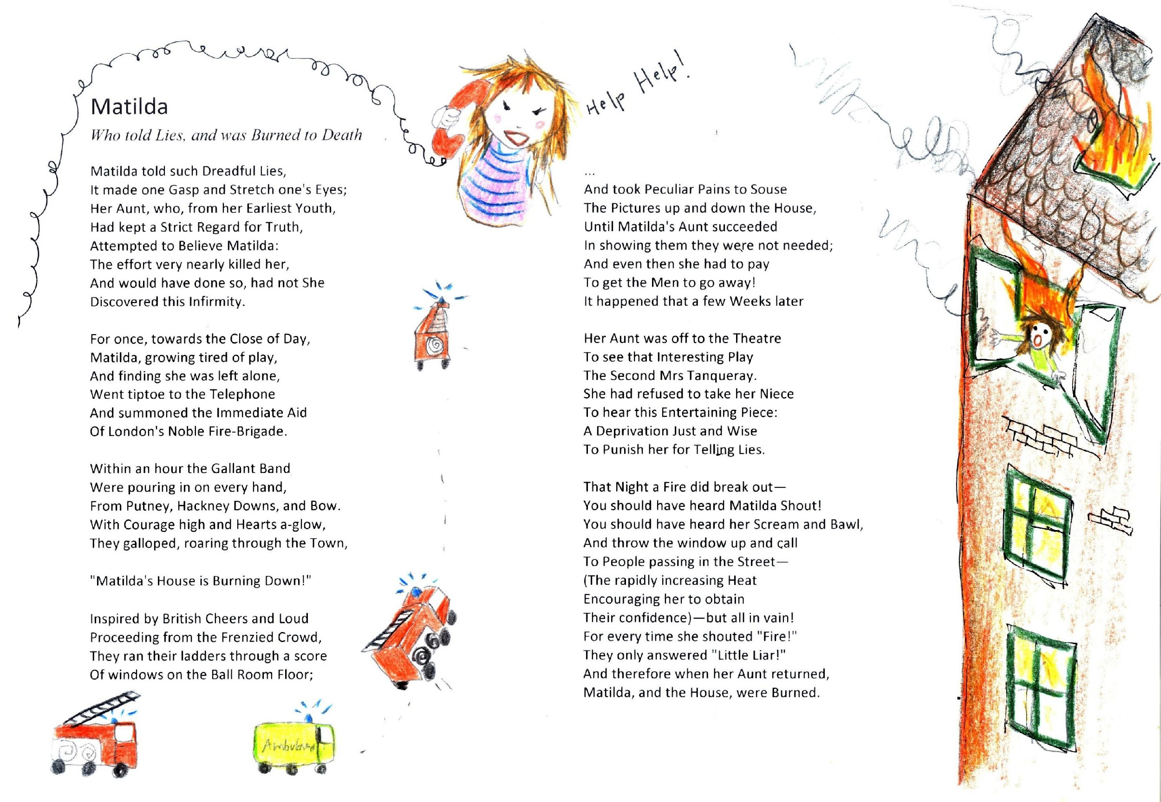
Notes:
Display and share Matilda (see resources). Discuss first impressions. Check understanding.

Slide 6
Monday 31st January 2022 LO: Prepare and present a point of view
Draw a mind map of each character/group of characters: what do you think of them?
Fire Brigade
Matilda
General Public
Aunt

Slide 7
Monday 31st January 2022 LO: Prepare and present a point of view
Questions to consider:
Is this poem intended to be taken seriously?
What clues are there?
No sympathetic characters
Sing-song rhythm/rhyme
Hyperbole
Irony
Notes:
Ask chn if they think this poem was intended to be taken seriously. What clues are there?
E.g. Use of hyperbole, no sympathetic characters, irony & effect of regular rhyme and rhythm to create a sing-song effect.

Slide 8
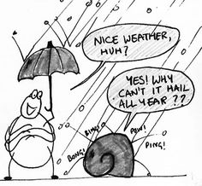
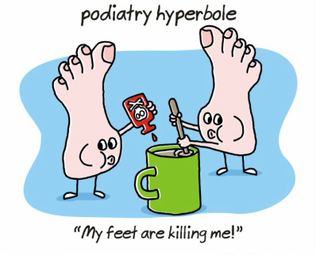
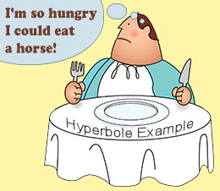
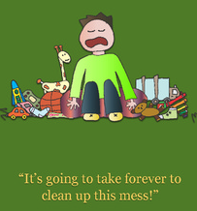
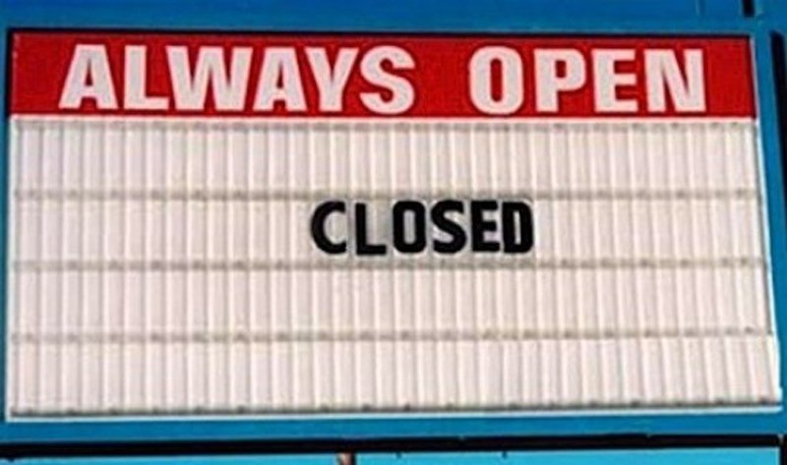
Monday 31st January 2022 LO: Prepare and present a point of view
Hyperbole
Irony
An extreme exaggeration used to make a point.
Where someone says, writes or does the opposite of what they actually mean.

Slide 9
Notes:
Display and share Jim (see resources). What similarities are there? Explain that these poems are parodies of earlier cautionary poetry which was designed to teach the reader a moral lesson.

Slide 10
Monday 31st January 2022 LO: Prepare and present a point of view
Draw a mind map of each character/group of characters: what do you think of them?
Zoo Keeper
Mum and Dad
Lion
Nurse
Jim
Friends

Slide 11
Monday 31st January 2022 LO: Prepare and present a point of view
What similarities are there?
These poems are parodies of earlier cautionary poetry, which was designed to teach the reader a moral lesson.
Parody: an imitation of the style of a particular writer, artist or genre with deliberate exaggeration for comic effect.

Slide 12
Monday 31st January 2022 LO: Prepare and present a point of view
My debate question:
My answer:
Evidence that defends my answer:
Evidence that might challenge my answer:
Re-read the poem you have been given with your partner.
Look for evidence to defend (support) or challenge (go against) your point of view for one of the questions below.
Extension – choose at least two questions to explore.
Are the fire brigade in Matilda really noble?
Is Matilda's aunt really wise?
Is the reader expected to feel sad about Matilda's fate?
Discussion connectives:
however, alternatively, whereas, on the other hand, although
for example, for instance,
furthermore, also, in addition
as a result, therefore, so, consequently
Who is to blame for Jim being eaten by the lion?
Is the reader supposed to feel upset by Jim's 'miserable end'?
Notes:
Give chn either Matilda or Jim & distribute copies of poems.
Chn reread poem and look for evidence that defends and challenges their point of view for one of the questions (HA choose two questions).
Chn record ideas, evidence & connectives linked to discussion in books.

Slide 13
Tuesday 1st February 2022 LO: Using expanded noun phrases
I can:
Develop expanded noun phrases.
Use expanded noun phrases to describe a character.

Slide 14
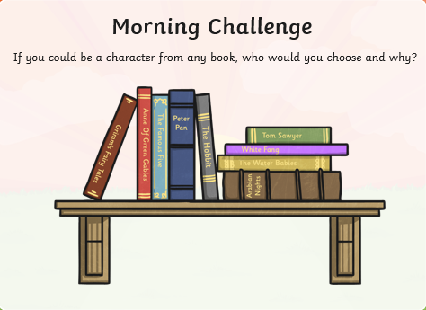
Think carefully about your choice.
Write the reasons for your choice.
What would you do if you could be this character?
How would you inspire others?
Think carefully about your choice.
Write the reasons for your choice.
What would you do if you could be this character?
How would you inspire others?

Slide 15
Tuesday 1st February 2022 LO: Using expanded noun phrases
Today we will develop the way we use descriptive language.
We will create descriptions of dreadful characters for cautionary tales.
Discuss with your partner the description of a verb, adjective, noun and preposition.

Slide 16
Tuesday 1st February 2022 LO: Using expanded noun phrases
Verb: a doing or being word (walk, am)
Adjective: describes a noun (red, clear, excitable)
Noun: name of something
Preposition: relation to another word (usually before a noun or pronoun)
Time (in the morning, at the end of the day)
Place (on the table, under the window)
Who/how (by myself, with enthusiasm)

Slide 17
The boy
Tuesday 1st February 2022 LO: Using expanded noun phrases
The reckless, rule-breaking, ten year old boy who chewed gum and lost all of his teeth.
The spoilt, snobby, gruesome girl who chewed food with her mouth open so wide a poisonous spider crept in.
Creating descriptions of dreadful characters
Verb, adjective, noun, preposition, article,
Notes:
Write 'the boy'. Quickly identify the noun and ask chn to generate a range of adjectives to describe the boy. Say that we could write a list of noun phrases (adjective+ noun) but this is quite repetitive and long-winded.
In order to convey rich language concisely, the chn will be practising creating expanded noun phrases.

Slide 18
Building dreadful descriptions
 | ADVERBS | ADJECTIVES |  | NOUNS |  | PREPOSITION
 |  | PERSONALITY | PHYSICAL | PERSON | FEATURE
the | extremely | cowardly | aggressive | girl | face | with
a/an | very | rude | smelly | boy | arms | under
that | rather | lazy | loud | lad | hands | behind
this | slightly | sly | quiet | lass | feet | over
her | faintly | bossy | hairy | baby | voice | across
his | somewhat | careless | spotty | child | smile
its | surprisingly | deceitful | tiny |  | eyes
 | vaguely | greedy | silent |  | nose
 | completely | gullible | pointed
 |  | foolish
An expanded noun phrase is a phrase which expands a noun.
It can be replaced with a pronoun.
The extremely bossy boy with vaguely smelly feet kicked the door.
He kicked the door.
Notes:
Display 'Building Dreadful Descriptions', emphasising that these are not complete sentences but are phrases that could be replaced with a pronoun.
Challenge chn to write sentences about dreadful characters and what they do, using expanded noun phrases. They could use the 'Building Dreadful Descriptions' chart as a starting point but encourage them to generate adjectives which develop their own particular character.
Share some examples and 'test' them by replacing with an adjective. Encourage improvement of any mediocre word choices or repetition. Ask chn to work with a partner to share writing and improve. Chn should keep ideas as a source for Wednesday's writing.

Slide 19
Independent work
Use the ‘Building dreadful descriptions’ table to create at least 5 sentences to describe a character and their personality or physical feature.
It doesn’t have to be the same character each time, it’s up to you each time.
Extension: Write a poem using your sentences. You can change them, add to them or move the order of them until you are happiest.
Ultimate extension: Make a limerick using your sentences.

Slide 20
Tuesday 1st February 2022 LO: Using expanded noun phrases
Building dreadful descriptions
The rather sly boy with deceitful eyes and silent smile.
Her faintly foolish baby with hairy arms.
A vaguely forgetful lass with a tiny voice.
His completely cowardly child with faintly smelly feet.

Slide 21
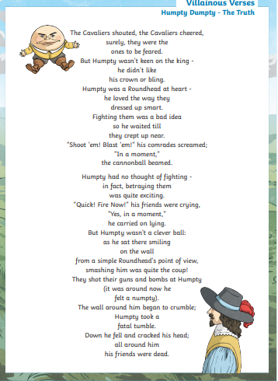
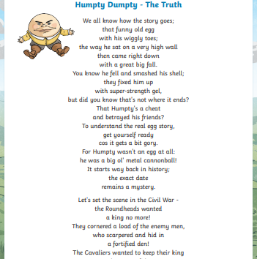
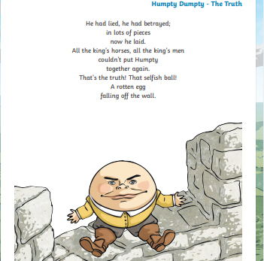
Plenary

Slide 22
Wednesday 2nd February 2022 LO: To plan a cautionary tale using expanded noun phrases
I can:
Understand the structure of a cautionary tale.
Brainstorm ideas for my own cautionary tale.
Use a thesaurus.
Use a rhyming dictionary.

Slide 24
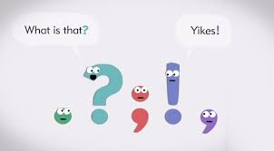
Wednesday 2nd February 2022 LO: To plan a cautionary tale using expanded noun phrases
Punctuating a noun phrase – how would you improve these examples?
The mad angry tired Girl with Blue gloves on ate some grapes like she’d never eaten before.
The rather fat funny boy with Big hands speaks loudly as he presented his work
Notes:
Consider the two examples and get the children to discuss and suggest improvements to highlight misconceptions. There are options to embed clauses, remove capital letters, add commas and hyphens.

Slide 25
Notes:
Read Henry King.

Slide 26
Wednesday 2nd February 2022 LO: To plan a cautionary tale using expanded noun phrases
Structure of a Cautionary Tale
A brief statement of the foible and hint of consequences;
A particular time where the foible causes terrible events to unfold;
The reaction of others/the moral stated.
Belloc uses hyperbole to exaggerate characters and reactions.
Hyperbole
Foible:
A minor weakness or eccentricity in someone’s character
An extreme exaggeration used to make a point.
Notes:
Remind chn about the purpose of these cautionary poems and establish that they all follow a similar 3-part structure:
Belloc's style uses hyperbole to create exaggerated characters and reactions. The silly tone keeps the poem light & amusing.

Slide 27
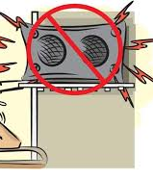
You will be planning your own cautionary tales in the style of Belloc about modern children.
Think about what a modern foible. It might be:
non-stop computer-gaming
texting whilst walking along the street
playing music too loudly on the bus, etc.

Slide 28
Wednesday 2nd February 2022 LO: To plan a cautionary tale using expanded noun phrases
Today is all about collecting and developing your ideas.
Discuss with your partner any ideas you have before writing them in your books. You can use ideas and vocabulary from Belloc's poems.
Use a thesaurus to find the most exaggerated synonyms and online rhyming dictionaries to collect useful pairs of rhyming words: www.poetry4kids.com/rhymes
By the end of today’s lesson, you should have a brief timeline of the events in your poem as well as a bank of vocabulary to use tomorrow.
You can use the following plan for a cautionary tale:
My character is ______________
Modern Day foible (make sure it will lead to your character's doom!)
What will happen to my character at the end
Exaggerated words for my character and their behaviour (e.g. frightful)
Exaggerated words for reactions of other characters or consequences (e.g. lamenting)
Brief timeline of poem events
Useful rhyme-pairs (e.g. fire/dire, text/next):
Online rhyming dictionary:
www.poetry4kids.com/rhymes

Slide 29
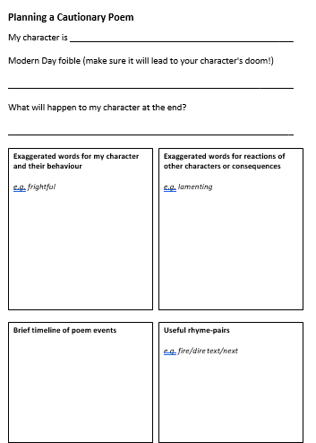

Slide 30
Thursday 3rd February 2022 LO: To write in the style of a poet
I can:
Write the first draft of a cautionary tale (poem).
Use a thesaurus.
Use a rhyming dictionary.

Slide 31
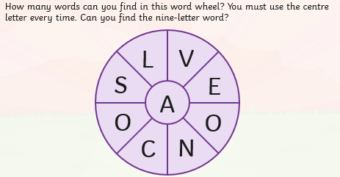
Word Wheel
How many words can you find in this word wheel?
You must use the letter A every time.
Can you find the nine-letter word?

Slide 32
Thursday 3rd February 2022 LO: To write in the style of a poet
Review your plans from the last session with a partner.
Today you will be drafting your poems.
Your work may be messy with notes and crossing-out, but this just shows how your ideas have developed.
Online rhyming dictionary:
www.poetry4kids.com/rhymes

Slide 33
Thursday 3rd February 2022 LO: To write in the style of a poet
Lifted from ‘Henry King’
The chief defect of Annie Spode,
Was constant texting as she strode,
As she went along the street,
She never once thought of her feet,
It led to such a dreadful fate,
The story I shall now relate!
One day a-texting as she went,
This rather foolish, girl was sent,
Down a manhole she had missed,
Chosen to rhyme with ‘strode’ – could have been any word that rhymed.
Two syllable word needed to maintain metre (al-ways, ev-er)
Street substituted for ‘road’ as it’s an easier word to find rhymes for.
Two lines lifted and adapted from ‘Jim’.
Clumsy rhythm, will work on this later.
Notes:
Model drafting some lines for a cautionary tale.
Model trying different words at the end of line for ease of rhyming using AABB rhyme scheme, noting that Belloc did not always find the best rhyme (foible/able, theatre/later) and saying the line aloud to check for rhythm.
Chn can use openers from Belloc's poems and trawl for useful rhyming word pairs.
Model leaving tricky lines for later and adding adjectives to create expanded noun phrases.
Remind chn that this is a draft and it is important to get ideas down first, then later tweaking for rhyme, rhythm & vocabulary choice.
LA: adult support and work in partners.

Slide 34
Thursday 3rd February 2022 LO: To write in the style of a poet
Share some of your favourite lines…
What works well?
Do you have a line you need help with?

Slide 35
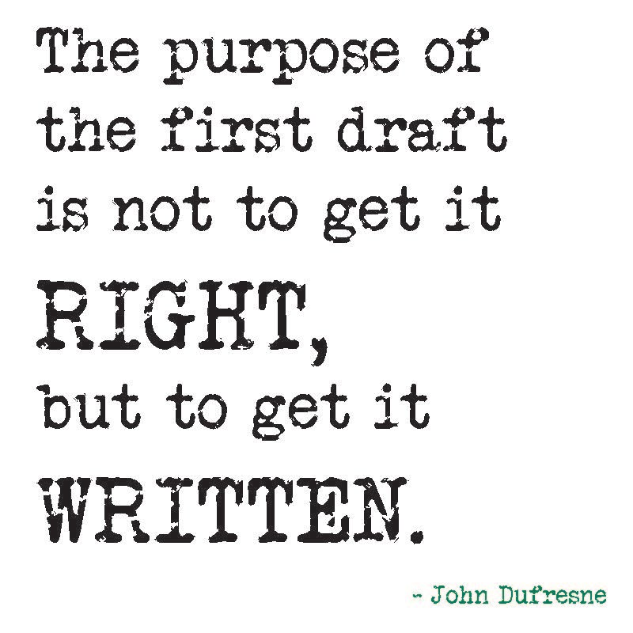
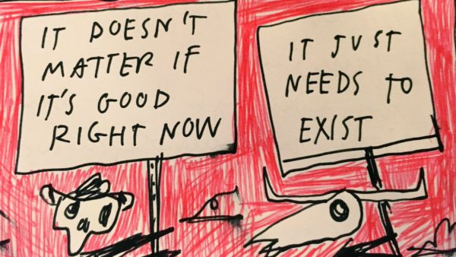
Independent work
You are now going to write your first draft of your poem.
Use your plan from yesterday.
Use the example we discussed today on slide 4.
Go back to Monday’s and Tuesday’s lessons if you would like to read the Cautionary Tales we read together earlier in the week.
Make sure you have a completed first draft with you for the lesson tomorrow.
Be proud of what you produce.

Slide 36
Friday 4th February 2022 LO: To perform a poem of mine
I can:
Edit and proof-read my writing.
Rehearse my poem.
Create my own success criteria.
Present my poem on paper and orally.
Notes:
INSET DAY

Slide 37
I

Slide 38
Edit and improve your poem, ready for performance
Read your poem carefully
Is it punctuated correctly?
Are the spellings correct?
Can any vocabulary be improved?
Are there expanded noun phrases included?
Extension:
Ask your partner to identify three things that work well and one thing to improve.
Notes:
Display a promising piece of writing from last session (scanned or enlarged).
Pick out features focused on during the last 2 sessions (structure, language choice, rhythm, rhyme) & agree what works well.
With permission, model rewriting the first few lines, discussing improvements.

Slide 39
Rehearse your performance
What do you think should be included in the success criteria for this?

Slide 40
Year 6 Who talked and talked until they could talk no more
The chief defect of 6RT
Was Talking Over Others incessantly.
It mattered not the Debate
The Class did not Discriminate;
Whispering, Laughing, Talking, Shouting.
The Raucous Group loved rule a-flouting!
It may not seem a great surprise
To discover this led to their demise.
One morning, through their Interjecting,
The Guest Orator, clearly objecting
To the children continuing impolitely
Their own conversations as he – quite rightly –
Attempted to re-establish calm,
Offered pupils an adhesive balm
Blended to bind their mouths together
Thus ceasing their chatter forever and ever.
Without interruption; constantly
Make a disturbingly harsh and loud noise
Recognise a difference
Openly ignore a rule or law
Say something abruptly as an interruption
Speaker
Disagreement
Sticky medicine
Stopping

Slide 41
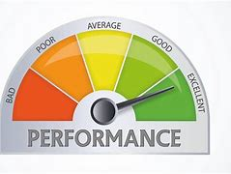
Friday 4th February 2022 LO: To perform a poem of mine
You could add props.
You could add actions.
Rehearse it before you send it in.
Think about your tone, volume, expression and rhythm.

