Slide 1
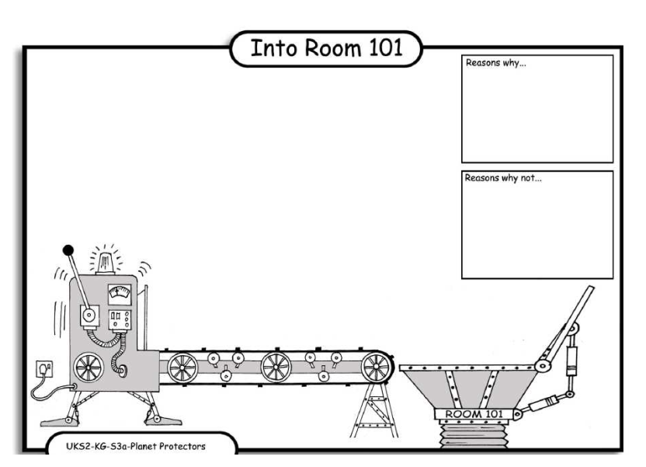
LO: Debating. 4.10.2013 Romell and Luke
Reasons why:
It makes the place smells and messy.
Reasons why:
Plastic bags stay in the dump and do not rot.
Reason why:
In sted of plastic bags you can yous bascits.
Reasons why:
Wen its windi pIASTIK bags
blow away.

