Slide 1
Starters
Today’s estimation.
http://www.estimation180.com/day-32.html
Use Hit the Button to practise times tables and division skills.
https://www.topmarks.co.uk/maths-games/hit-the-button

Slide 2
Problems of the day

Slide 3
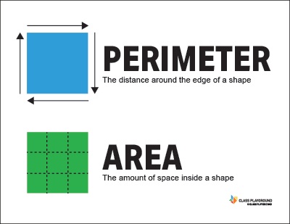
What is perimeter?

Slide 4
Play the video below if you want to remember the fantastic song!
https://www.youtube.com/watch?v=n5ULJ_kcFzI

Slide 5
Play this video – It is good to see how it is explained in different ways and with different shapes, helping you to have a better understanding. Note – you may not be able to open in Internet Explorer – copy and paste the link into Google. It does work.
https://www.khanacademy.org/math/basic-geo/basic-geo-area-and-perimeter/basic-geo-perimeter/v/perimeter-of-a-shape

Slide 6
Try this website for activities. The first activities are good for building your own shapes.
https://www.topmarks.co.uk/Search.aspx?q=perimeter

Slide 7
Try some of these – don’t forget to include every side. You may need to find one or two of the sides before you add them all up.

Slide 8
Answers
1 - 34cm
2 – 146m
3 – 969m per day (323 x 3 times)

Slide 9
Answer one of the questions below in the comment section.
In the comment section below explain what you know about area.
The next two lessons will be about area.
What is the definition of area?
Can you give an example?
How would you find area? Of a rectangle?
Of a compound shape?

