Slide 1
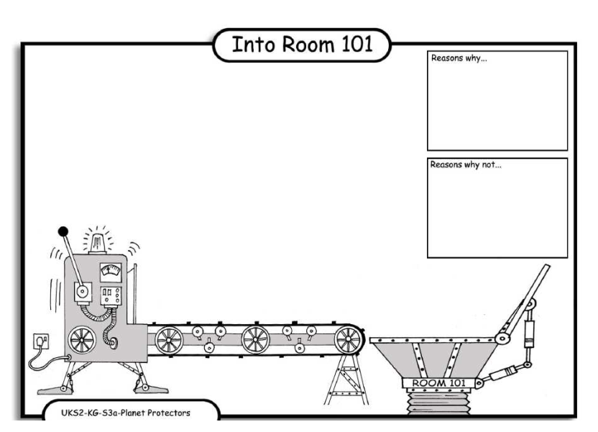
LO: Debating. 4.10.2013 Emmanuel and Shamailah
Reasons why:
If they no bags we woud yous buskits.
Reasons why.
It is bad because they smell and they hert are world.
Reasons why:
They cause rats to give dses and they hert are world.

