Slide 2
1) 100, 200, ___ , 400, 500, 600, ___ , ___
2) 80 $+$ ____ $=$ 100
3) 78 $+$ ____ $=$ 100
4) ____ $+$ 45 $=$ 100

Slide 3
1) 100, 200, ___ , 400, 500, 600, ___ , ___
2) 80 $+$ ____ $=$ 100
3) 78 $+$ ____ $=$ 100
4) ____ $+$ 45 $=$ 100
300
700
800
20
22
55

Slide 4
Friday 18th September 2020
LO: I can round to the nearest 100
Success Criteria:
I can use my knowledge of multiples of 100
I can use this knowledge to work out which 2 numbers a number sits between.

Slide 5
Round 130 to the nearest 100
100
100
110
120
130
140
150
160
170
180
190
200

Slide 6
Round 130 to the nearest 100
30
70
100
110
120
130
140
150
160
170
180
190
200
130 is closer to 100 than 200
130 rounded to the nearest 100 is 100

Slide 7
Round 138 to the nearest 100
38
62
100
138
200
138 is closer to 100 than 200
138 rounded to the nearest 100 is 100

Slide 8
Dora is thinking of a number.
It rounds to 400 to the nearest 100
It rounds to 450 to the nearest 10
What could Dora’s number be?
445
446
447
448
449
450
451
452
453
454

Slide 9
Round to the nearest 10
0
ones
1
one
2
ones
3
ones
4
ones
5
ones
6
ones
7
ones
8
ones
9
ones
Round to the nearest 100
0
tens
1
ten
2
tens
3
tens
4
tens
5
tens
6
tens
7
tens
8
tens
9
tens
482
713
859

Slide 10
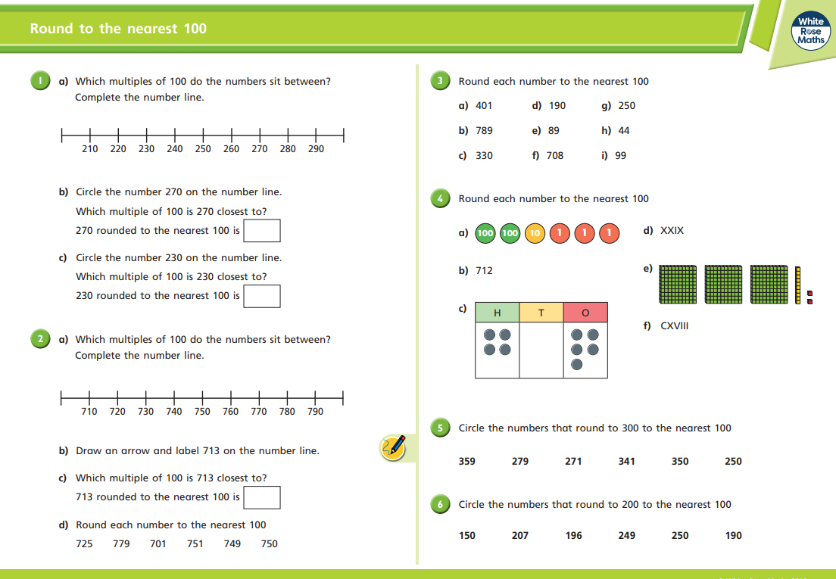
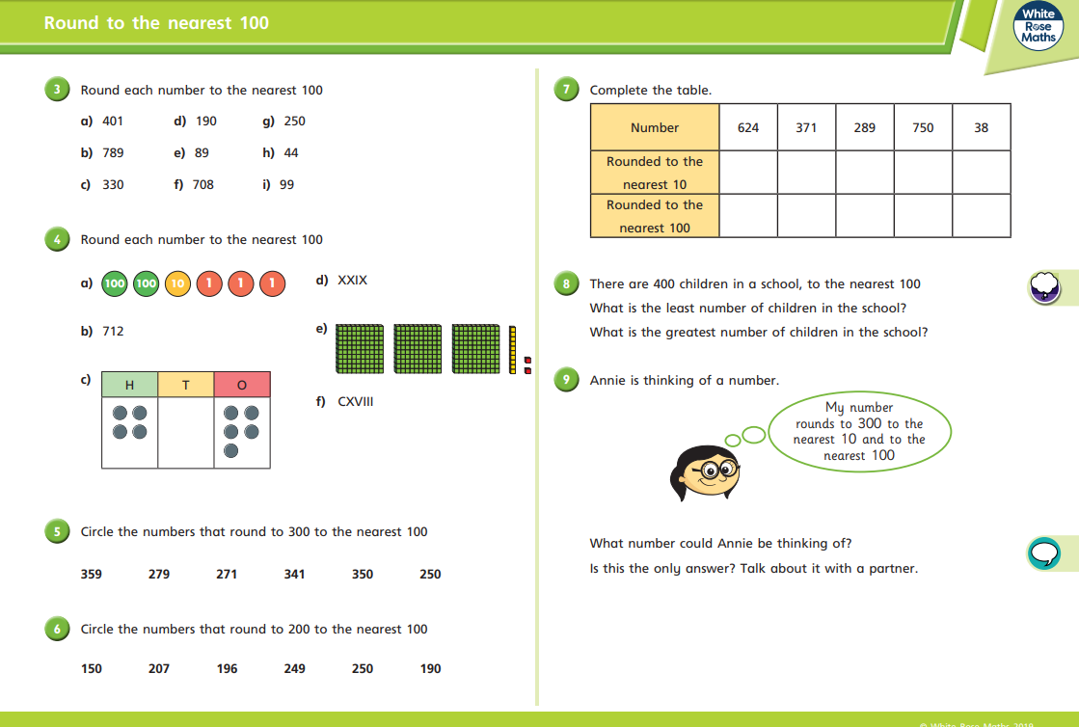
Main task
Extension

