Slide 1
Week 1 Day 1 Home learning English
Similes and Metaphors

Slide 2
Home learning focus
To identify similes and metaphors and be able to use them in your writing.
This lesson includes:
Two videos to help you understand similes and metaphors
Three follow up activities

Slide 3
Task 1:
In your home learning books, write today’s date and the title of the lesson.
Task 2:
head over to https://www.bbc.co.uk/bitesize/articles/zk68wty
There is two videos and some examples to watch and explore followed by four practice activities.

Slide 4
Activity 1
Check how well you understood the videos by completing this short activity.
You need to decide whether each sentence is a simile or a metaphor.
This is a fill in the gaps activity – follow the video in activity one on the linked website above to complete it.
Top tip!
Metaphors say something is something else. Similes says something is like or as something else.

Slide 5
Activity 2
Complete this activity by changing all the boring descriptions into exciting similes and metaphors.
For example:
The shark had sharp teeth.
The shark had teeth as sharp as razors.
1. The cat was black.
2. The moon was shining.
3. The dog ran after the tennis ball.
4. Bobby was hungry.
5. The trees swayed in the breeze.
6. Sarah did well in her dance show.
Remember: similes use the words like and as whereas metaphors say something is something else.
Top tip!
Your similes and metaphors still need to match what is being described. For example, ‘as quiet as an elephant’ doesn't make sense as elephants are big and loud, but ‘as quiet as a mouse’ does because mice are small and quiet.

Slide 6
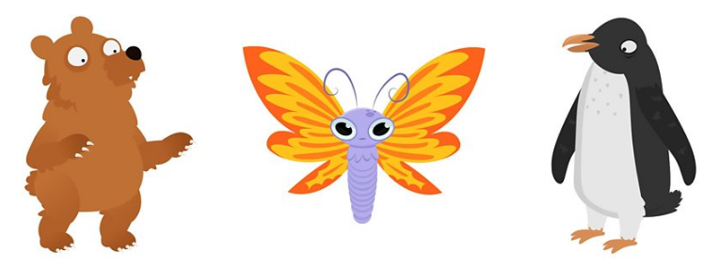
Activity 3
Lots of poets use similes and metaphors in their poetry.
Here's an example of a poem written entirely using similes and metaphors.
Tiger Claws as sharp as daggers, A mouth of deadly pearls. Orange fur like fire, Sneaking silently, a ninja.
Write your own poem about an animal using only similes and metaphors.
You could also draw a picture to illustrate your poem.
If you need some inspiration, choose one of the animals below to write your poem about.

