Slide 1
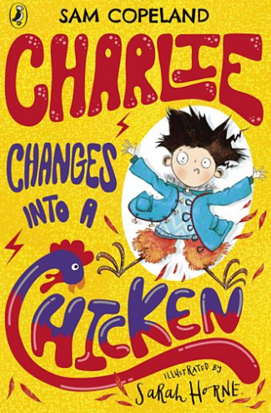
Week 2 Day 2 English
Charlie Changes Into a Chicken by Sam Copeland

Slide 2
Home learning focus
Using the book Charlie Changes Into a Chicken you will learn how to explain how the writer’s choice of words creates humour and to write in the style of an author.
This lesson includes:
two videos of presenter and blogger Mehreen Baig reading extracts from the book
three activities

Slide 3
Task 1:
In your home learning books, write today’s date and the title of the lesson.
Task 2:
head over to https://www.bbc.co.uk/bitesize/articles/zrcnf4j
There is two videos and some examples to watch and explore followed by three practice activities.

Slide 4
Practise
You may need paper and a pen or pencil for some of these activities.
Read extract 1 and try activity 1 below.
Extract 1
The sound of his parents arguing downstairs rumbled through the house, low like thunder. Charlie closed his book. He couldn't concentrate.
Darkness had fallen outside and the street light outside Charlie's window was making uncanny shadows on his bedroom wall.
The silhouettes of the tree branches looked a little too much like log clutching witches' fingers for Charlie's liking. So, quick as a flash, he sprang out of bed and pulled his curtains together.
It was there and then that it first happened.

Slide 5
It began with a twitching in his eye. Charlie froze to the spot, feeling his eyelid blink manically. His eye had twitched before, when he’d been tired, but this felt different somehow. It felt like somebody had just plugged him into a wall socket. The twitching spread to his other eye, and both eyes were blinking and twitching.
A feeling burst through the whole of his body, like he’d just been shot through an electrical wire, like he was the electricity.
Every part of his body fizzed and hummed. The fizzing and humming became stronger, until he felt like he was on fire, but a fire inside of a never-ending tube, squeezed and vibrating.
His skin felt extraordinary. Alive. He looked at his arm and, with some considerable alarm, saw that hair was sprouting out of every part of his skin.
Weirdly the room was growing larger too.
But no, Charlie realized, the room wasn’t growing larger – it was him who was shrinking!

Slide 6
Activity 1
Read extract 1 again.
Return to the beginning of the extract and summarise what is happening in the text.
Try to write eight different phrases or clauses to summarise the plot.
Challenge yourself by using a maximum of 6 words for each phrase or clause.
You can choose where in the extract to pause and write a summary.
Here are a few examples to start you off:
what is happening?
eye twitching
frozen to spot

Slide 7
Extract 2
He reached up with one of his new, long, spindly black legs and carefully counted his eyes. There were eight.
Eight legs? Eight eyes? Veeery suspicious.
So Charlie looked at all the suspicious evidence and added small + hairy + eight spindly black legs + eight eyes together and got spider as the answer because it is a well-known fact that spiders are hairy and have eight legs and eight eyes. It’s a less-known fact that spiders also have eight bums, which is both disgusting and messy and also costs spiders loads of money in toilet roll.
Charlie sat on the floor and considered his predicament. He had turned into a spider and he had no idea how to spider. He’d had lots of practice being a boy, but zero practice spidering. After a short while just sitting there being a spider, Charlie came up with a plan. The plan had two simple steps. They were:
Step 1: PANIC!!!
Step 2: Shout to his mum to come and help.

Slide 8
Activity 2
Sam Copeland creates humour in his writing.
Read both extracts again and find examples of humour – where the author makes you laugh.
Choose your favourite two examples and explain how Sam Copeland’s choice of language creates humour.
Example From The Extracts | How Did The Writer’s Choice Of Language Create Humour?
Example 1
Example 2

Slide 9
Activity 3
Read the end of the second extract again. The writer leaves the story on a cliff-hanger and the reader is waiting to see what will happen next.
Write the next paragraph in the style of author Sam Copeland.
Top tip!
Think about what might happen.
For example, will Mum come straight away? If she does, will she know what has happened or will she think Charlie is a spider and then throw him out? What if Mum does not come? Will Charlie have a Step 3 to his plan?

