Slide 1
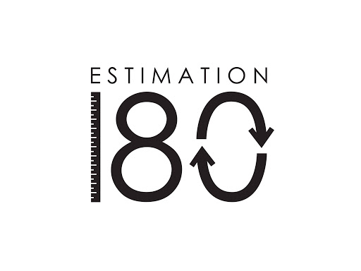
Starters
Today’s estimation – it is a very topical one! I realised that I put yesterday’s and today’s in the wrong order so yesterday will have given you clues for today’s one.
http://www.estimation180.com/day-28.html
Use Hit the Button to practise times tables and division skills.
https://www.topmarks.co.uk/maths-games/hit-the-button

Slide 2
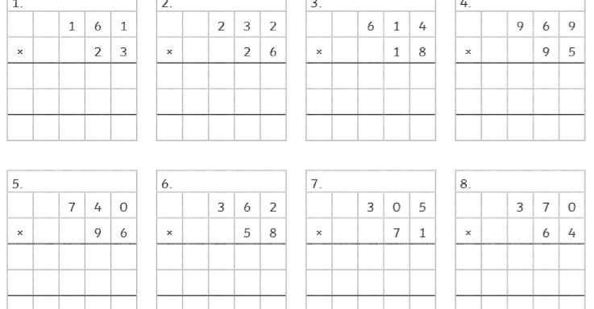
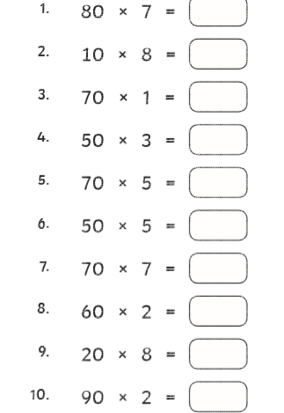
Times table practise – choose your challenge or challenges

Slide 3
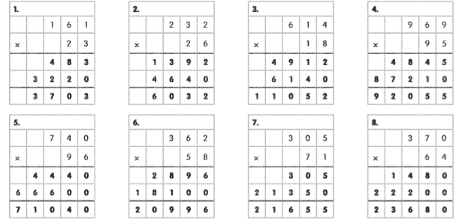
Answers

Slide 4
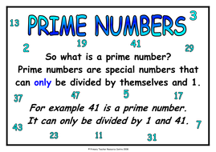
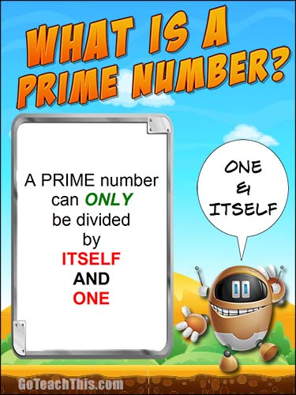
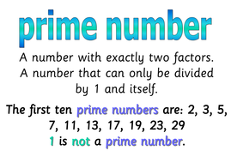

Slide 5
Enjoy the rap below to revise prime numbers
https://www.youtube.com/watch?v=cRz4hW9SPPc

Slide 6
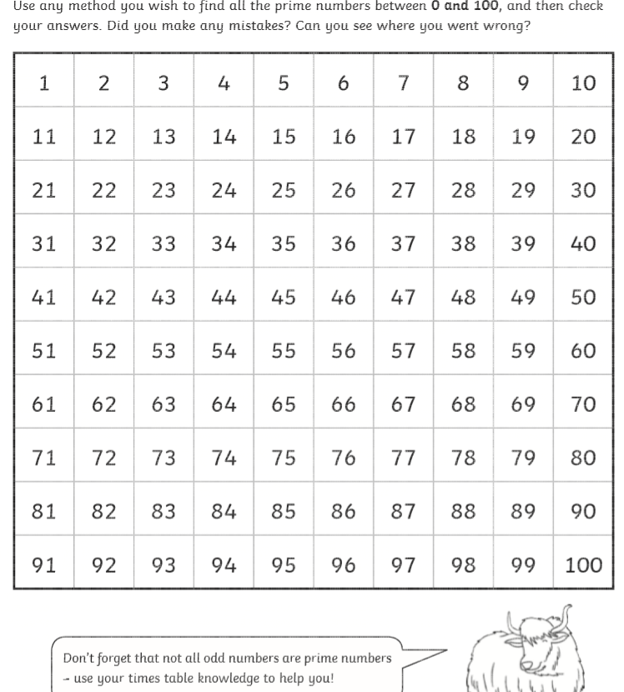
Activities
Click on the link below. You will be able to make your own prime number chart.
Alternatively, you can make your own in your book.
https://www.mathsisfun.com/numbers/prime-number-activity.html

Slide 7
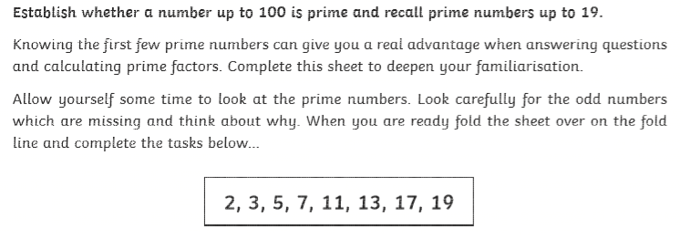

Slide 8
Answers

Slide 9
