Slide 1
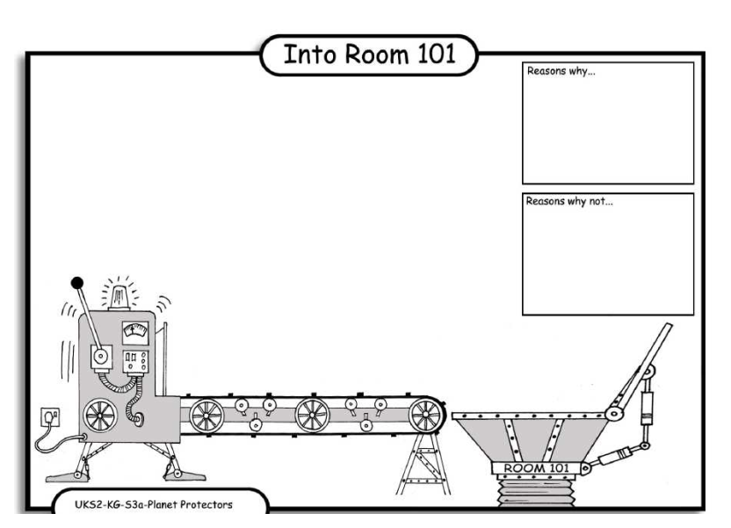
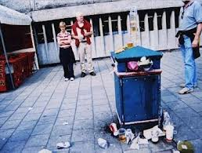
LO: Debating. 4.10.2013 Sam and Robin
Reasons why:
People can trip over it.
It does’t look nice
Reasons why
It can caes rats to come.
Reasons why:
It smells very bad

