Slide 1
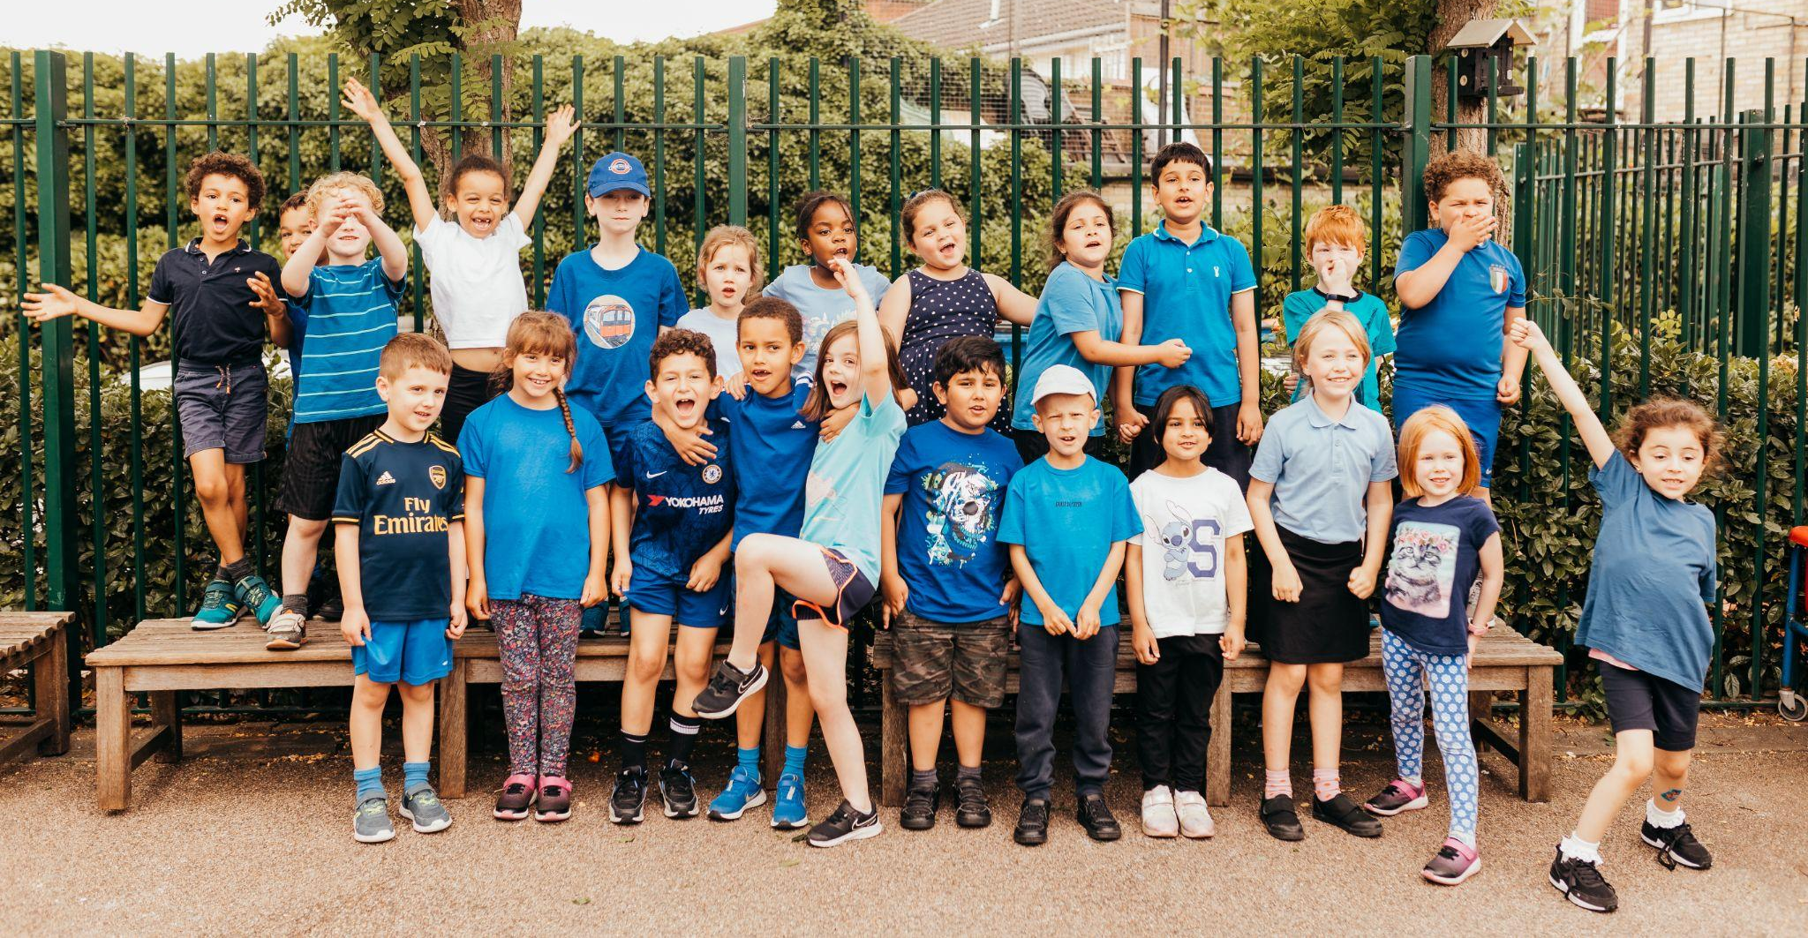
HANDSWORTH PRIMARY SCHOOL
WEEKLY NEWSLETTER
Friday 1st July 2022
Mrs Nairne’s Headlines
Assemblies
Donations & Volunteers
Summer Picnic
A huge congratulations to the children who have led their year group assemblies over the last couple of weeks. I was so impressed with the confidence shown.
It was great to hear about what the children have been learning. Parents and carers , it is good to ask your children questions after school such as:
Tell me something you have learnt today
Tell me something you are proud of
What made you happy today?
This way, we get more information from our children and it allows us to focus on positive learning experiences.
Thank you all for the offer of donations. We now have enough books and toys in school for the children.
We are always on the lookout for Lego so would really appreciate that for our sensory room.
We are also very keen for parents and carers to come and volunteer in school. Our children love to read to trusted adults in school or do extra interventions where they can. Our volunteers are always DBS checked and work under the direction of the class teachers.
Nothing brightens your day like working with children!
We are all very excited about the Summer Picnic tomorrow! It looks like it is going to be dry. The Picnic starts at 11am and finished at 5pm. We have our colour run at 1pm.
Thank you to Friends of Handsworth for organising this event, we are looking forward to coming together as a community and raising much needed funds for our school. We are asking for plenty of volunteers to help in the morning to set up the event. This will be from 9am - 11am please.
Please contact maxmax032@gmail.com if you can help with set up.
Please can cake donations be dropped off in the morning of the 2nd July at anytime from 10.30am.

Slide 2
We are also hosting our first Colour Run!
Colour run is a two-kilometre, untimed event. At each station mark, colour runners are doused from head to toe in a different coloured powder.
Handsworth parents can book now using our events website link below:
https://www.pta-events.co.uk/friendsofhandsworth/
This event is open to the whole community, please get in touch with Naomi on murraynaomi@yahoo.com to book your place.
Match funding
Our Summer Picnic is a great opportunity to contact your HR department and request Match Fund Scheme details. This is one of the simplest ways to help us raise extra money for the school. If you need to understand more about how match funding works, please contact us.
We are very excited about our Friends of Handsworth Summer Picnic which is being held:
Date: Saturday 2nd July
Time: 11am to 5pm
Colour Run 1pm
Location: Highams Park Secondary School Field (Entrance via Handsworth Primary school)
Special thanks to HP Radio, who are going to be playing amazing music and live streaming onto their radio station.
Huge thank you to McRaes for sponsoring our Summer Picnic and WJ Meade for sponsoring our Colour Run event.

Slide 3
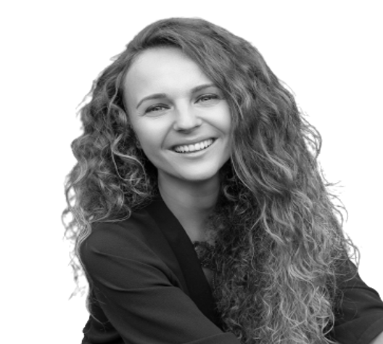
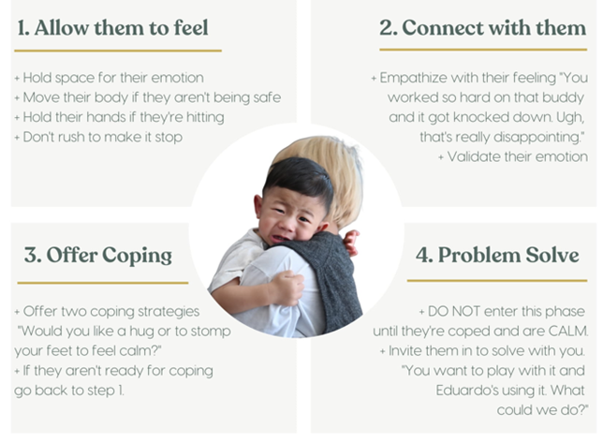
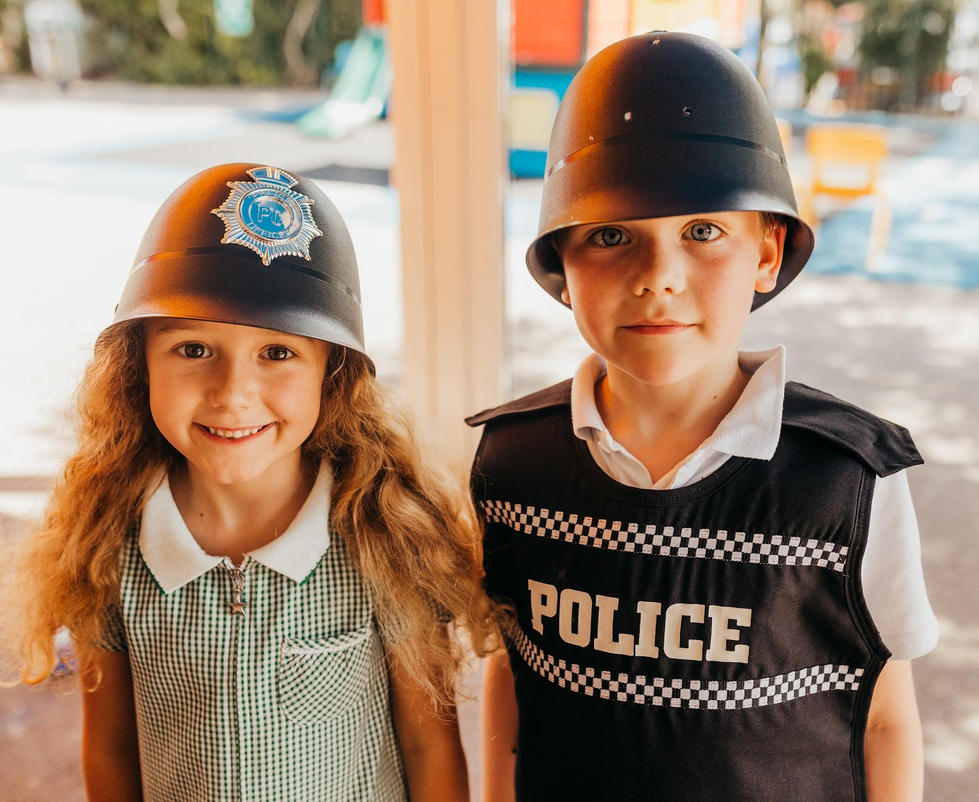
What to do when you feel your temper rising
We all have triggers – our children certainly do and so do we! So what can you do when you feel
your temper rising? We often feel the urgent need to DO something, but that is our emergency
response system operating. Quite often, however, you do not need to DO anything other than
notice what you are feeling, breathe your way through it and restore yourself to calm before you
act.
How can parents help?
First of all, know your triggers. Notice them, as well as what happens in you when your buttons
have been pushed. If you can catch it early, you are more likely to feel you have a choice in your
response. If no physical intervention is absolutely required (in a safety situation) just hold still and
breathe. Resist taking action for now and work hard to see things from your child’s point of view:
what do they need your help with? Finally, always choose love, not fear: set limits but do it with
empathy, move into a playful mode and always be ready to offer a hug.
Greta
Integrative Child Psychotherapist
and Parent Consultant
www.seedandsew.org/parents
Please can you use the post box outside the office for letters and envelopes that need to be given to the school office. Thank you.

Slide 4
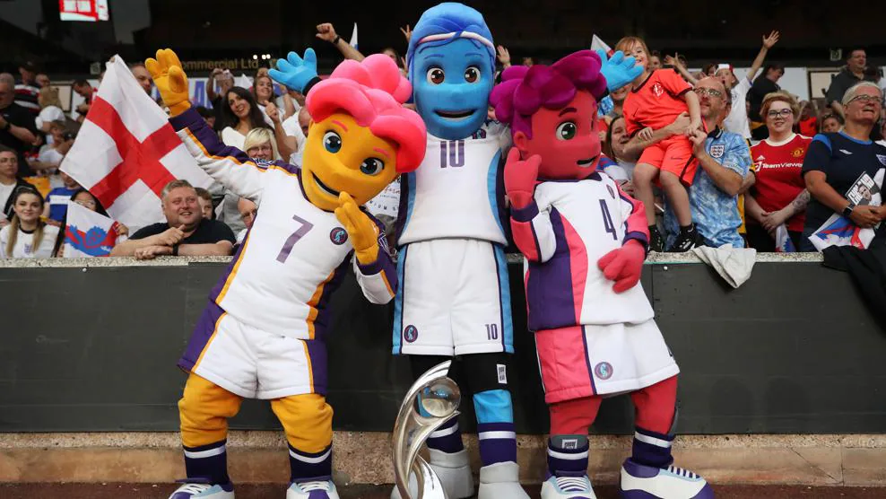
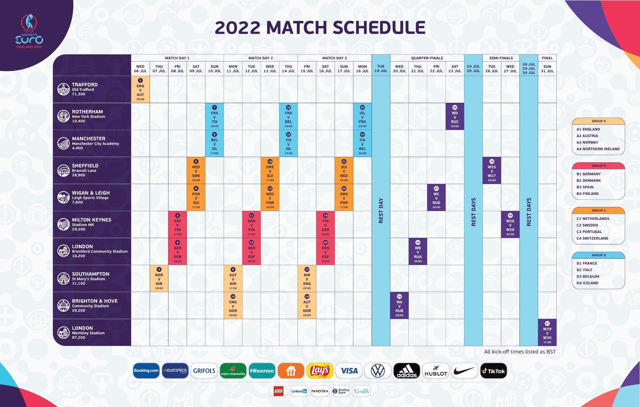
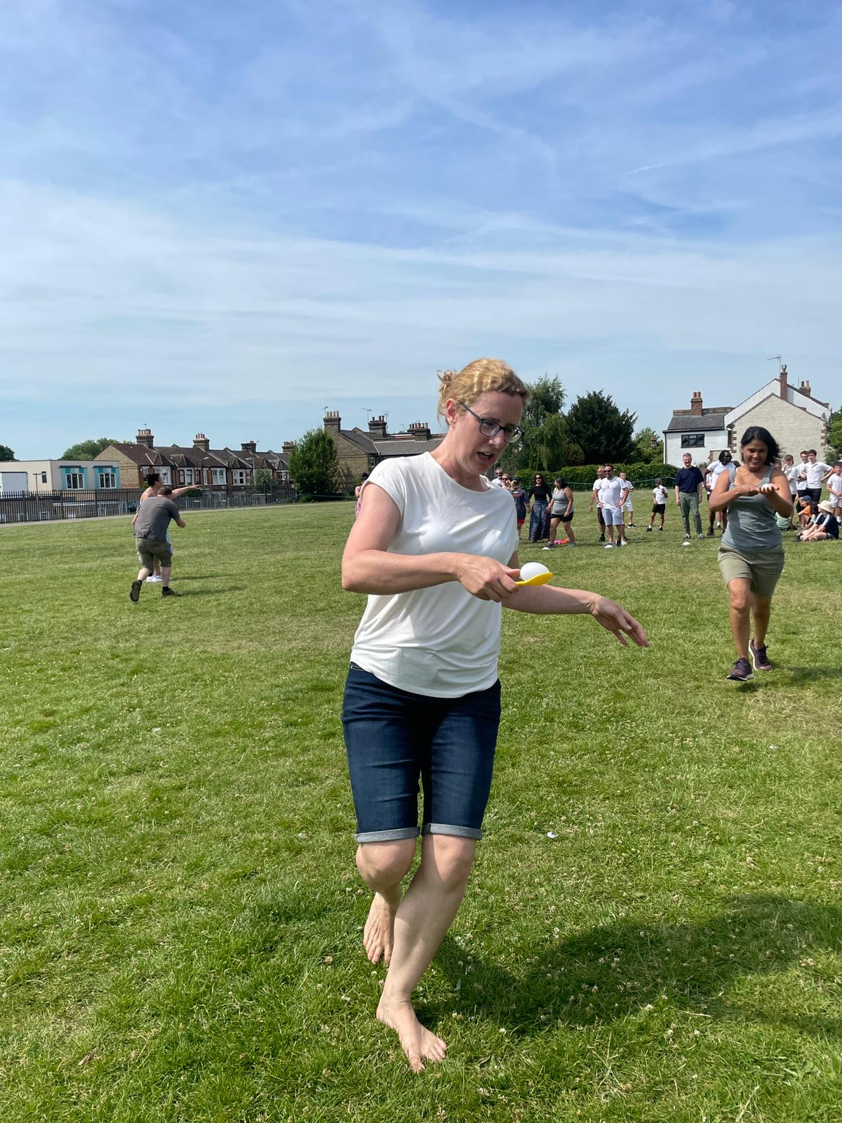
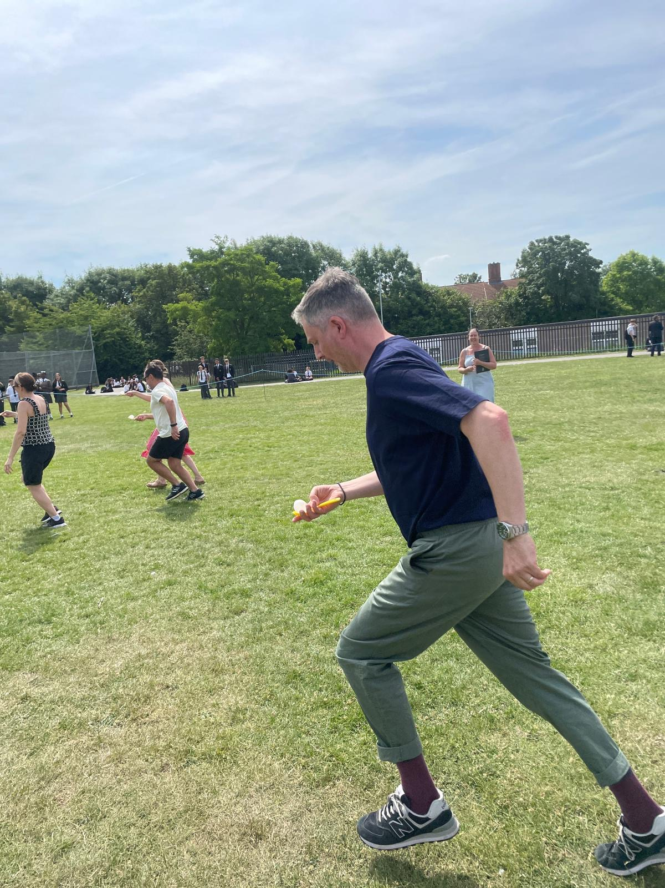
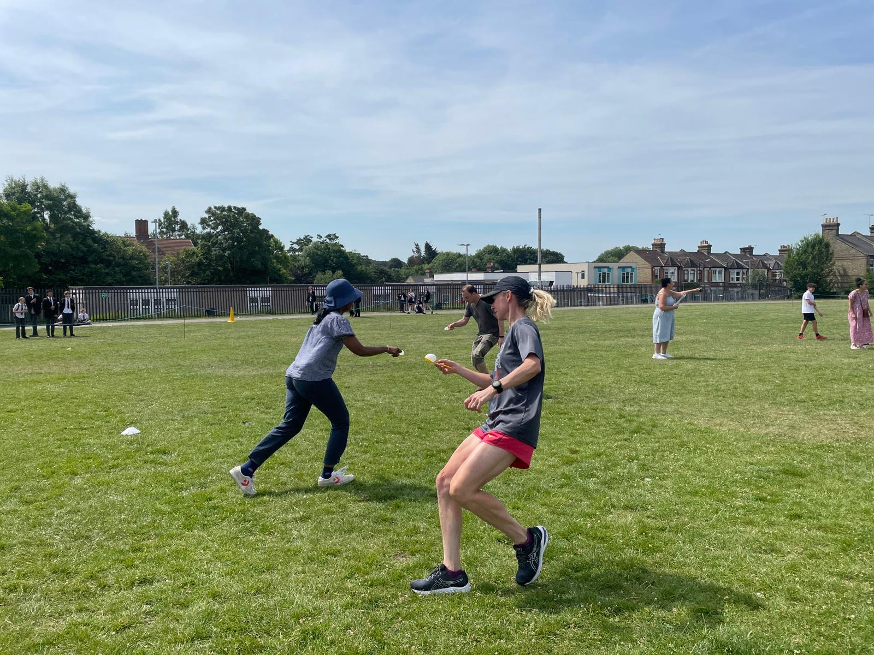
England kick off the tournament against Austria on 6 July at Old Trafford, with the final at Wembley on 31 July.
Parent races at Sports Day!

Slide 5
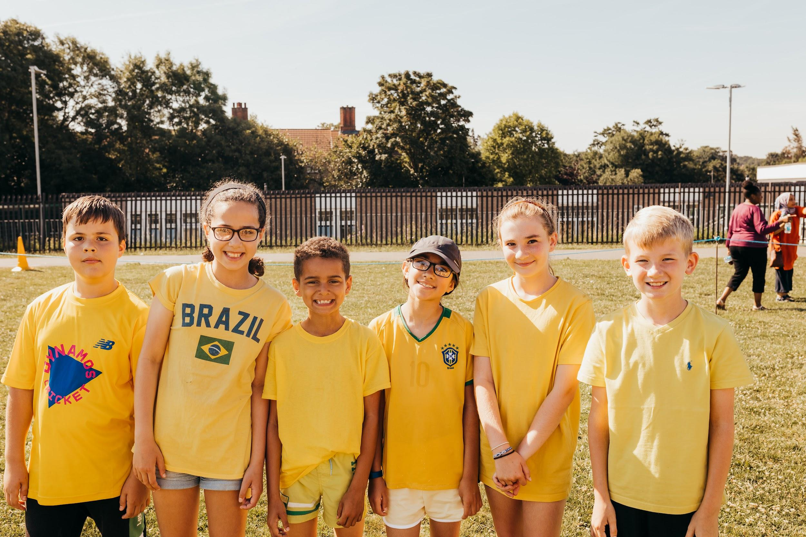
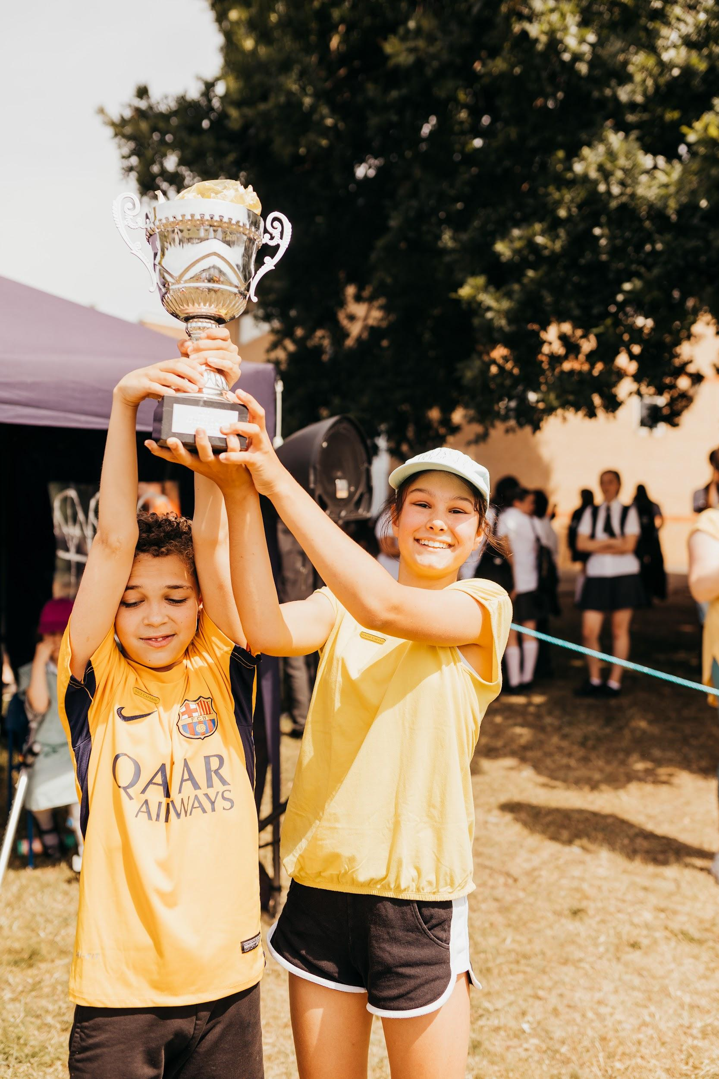
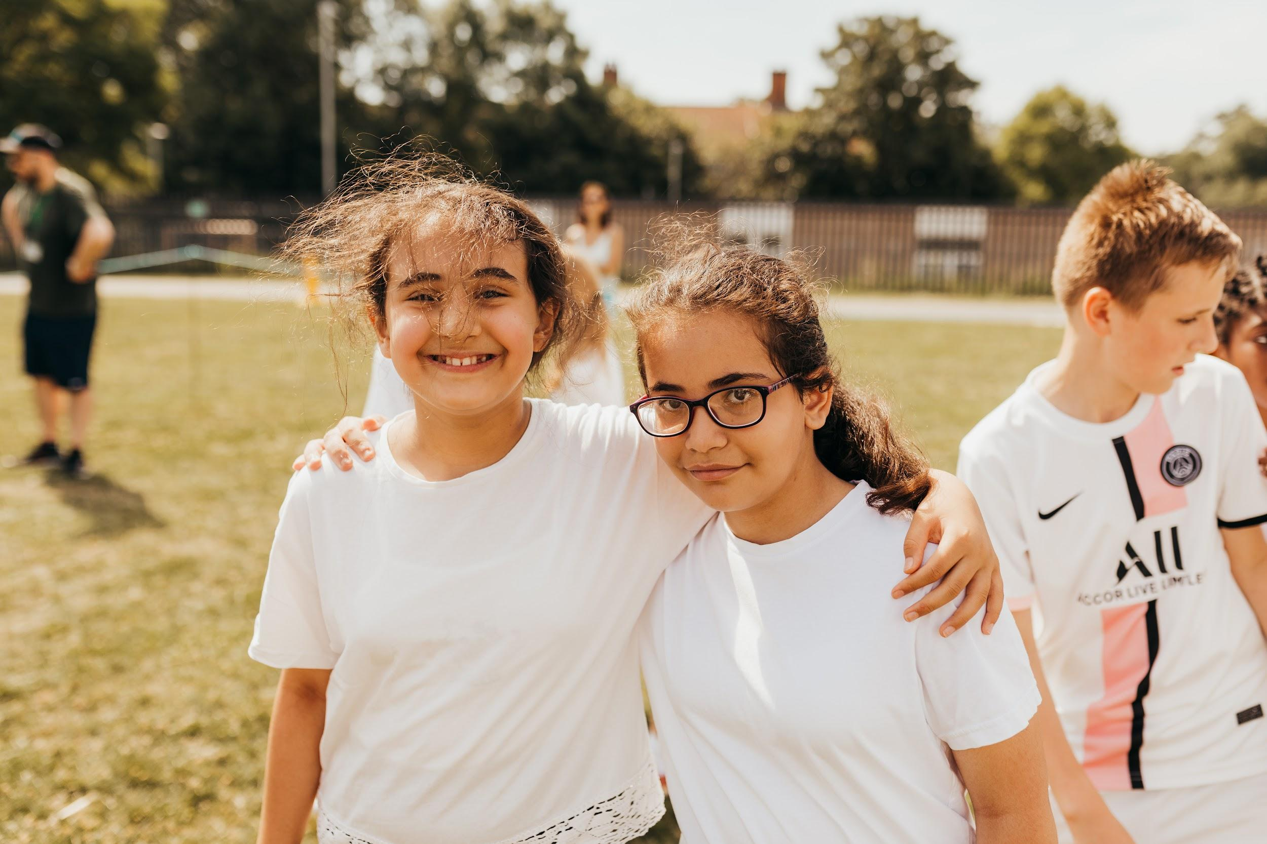
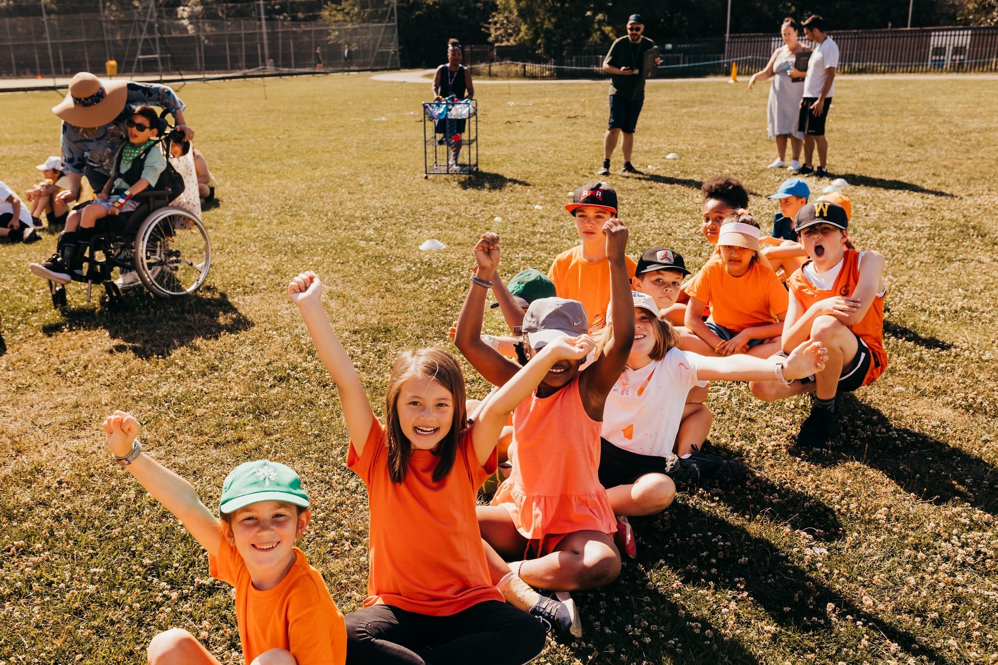
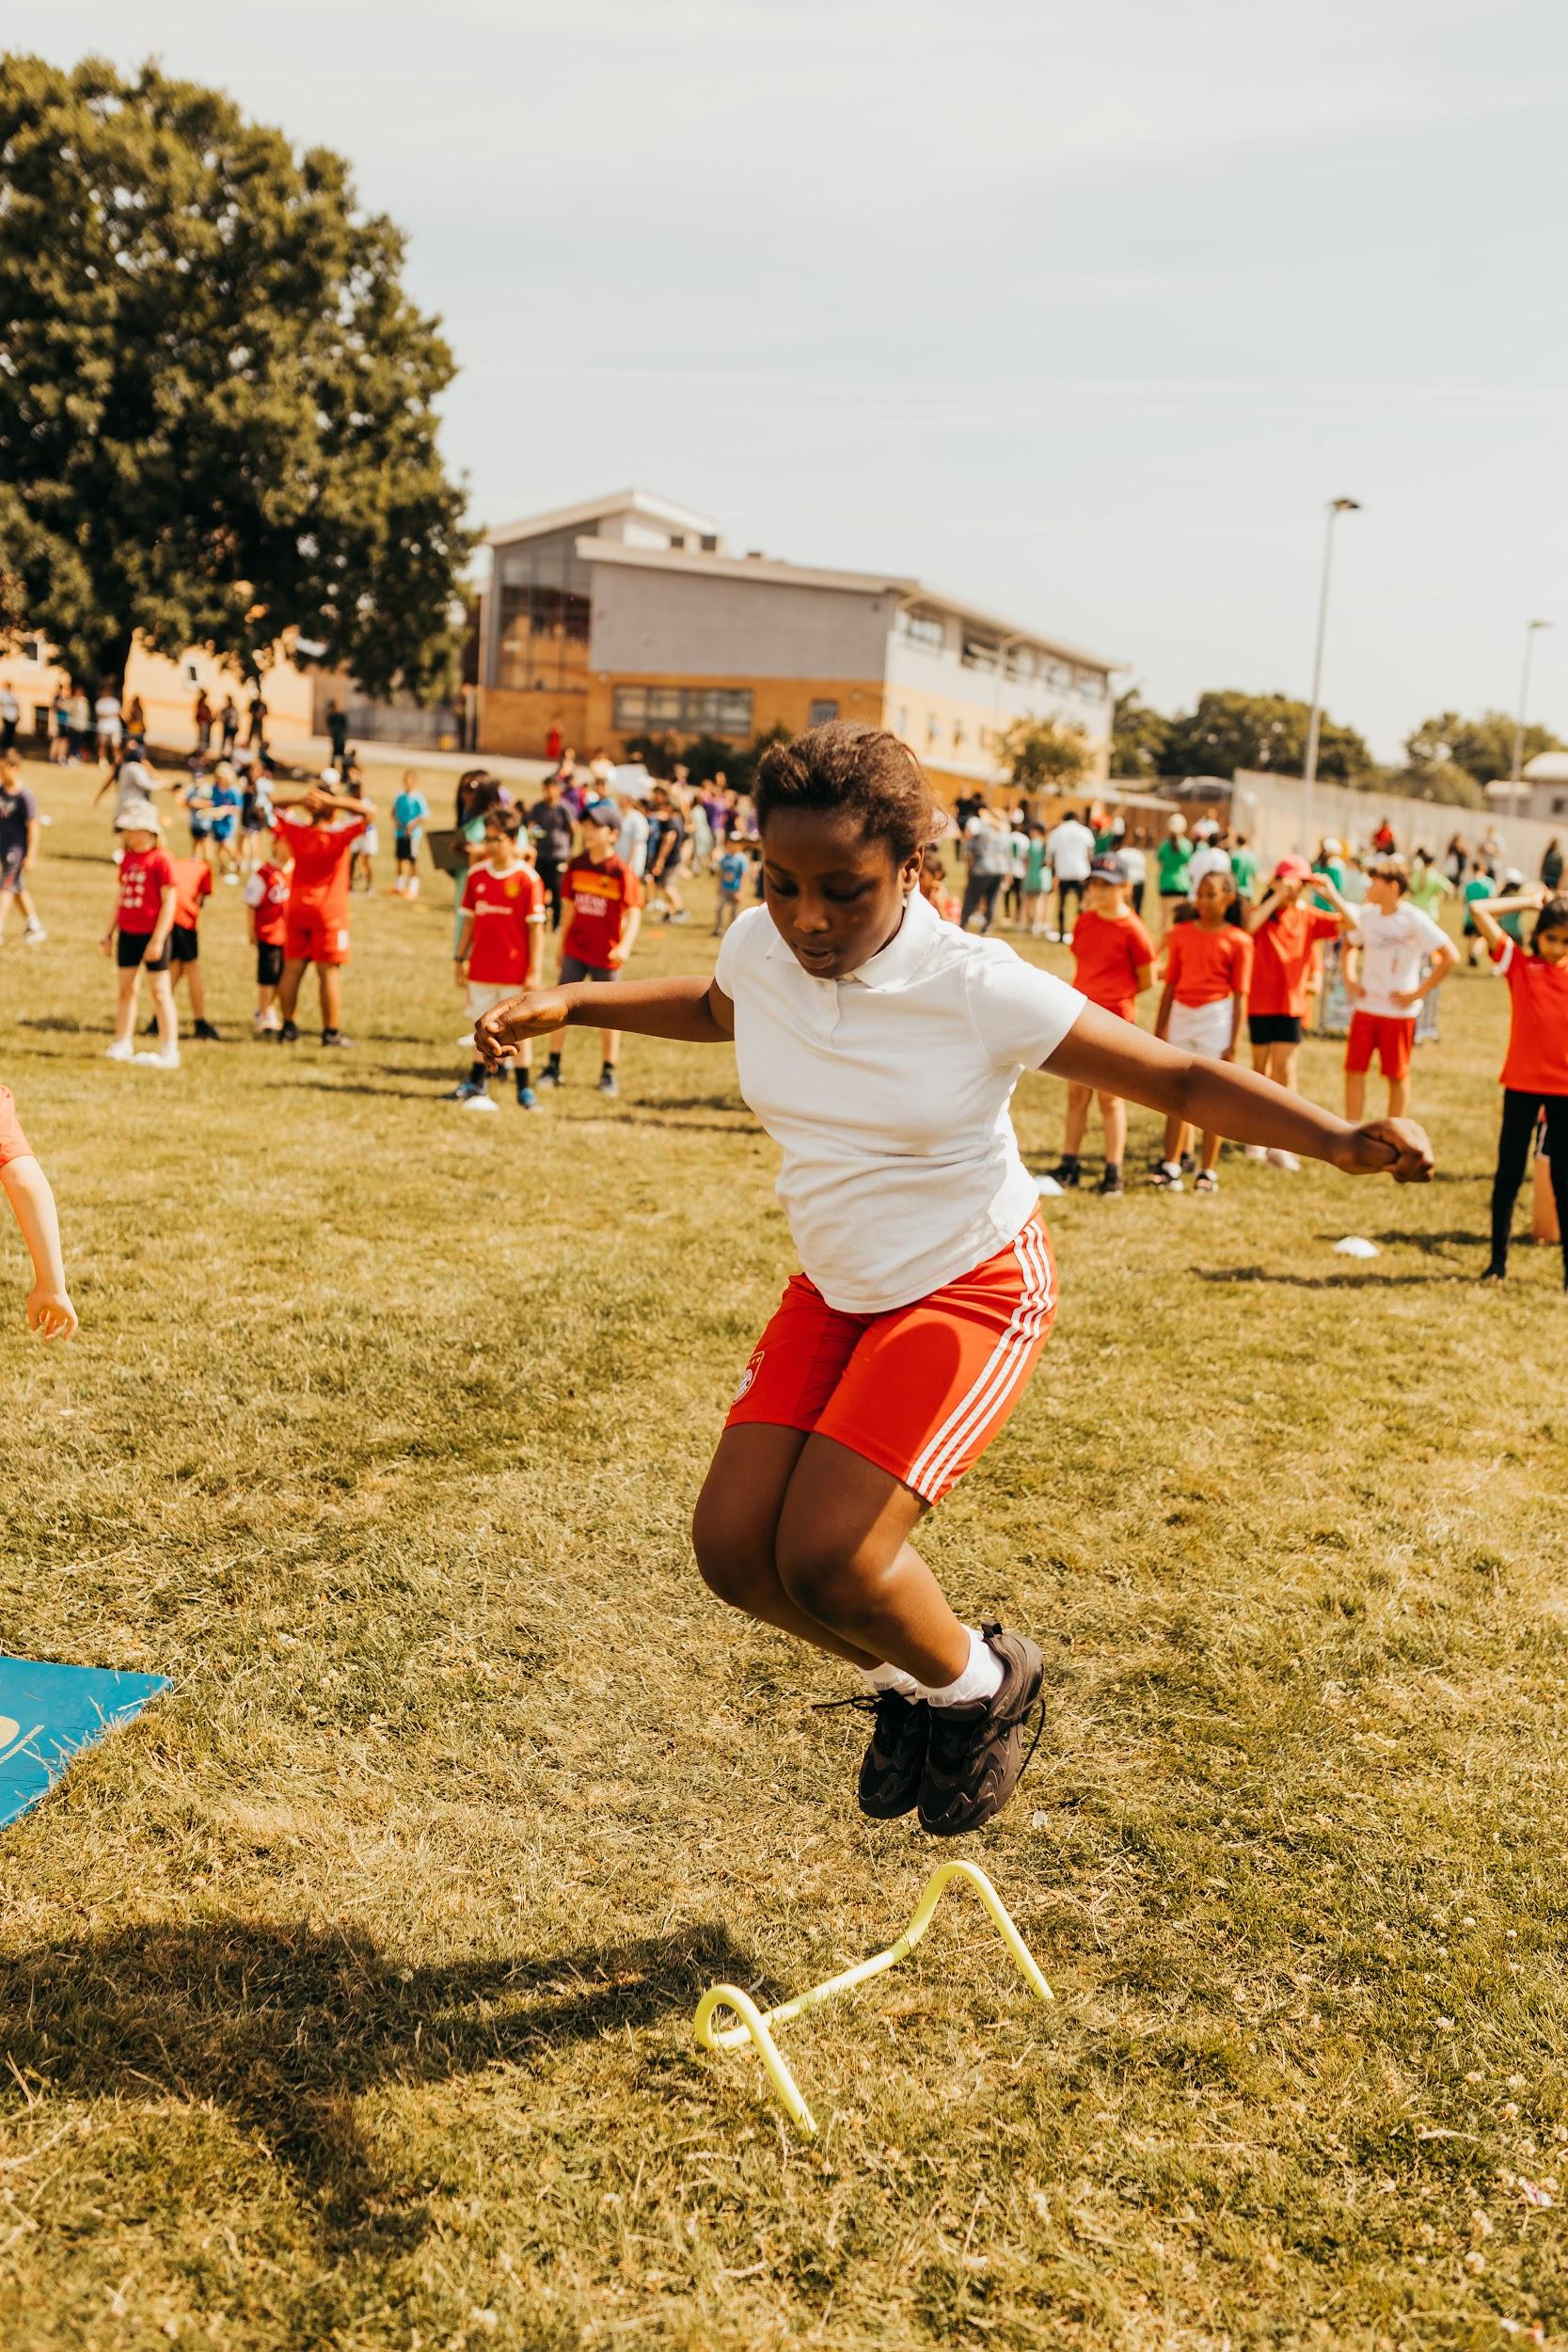
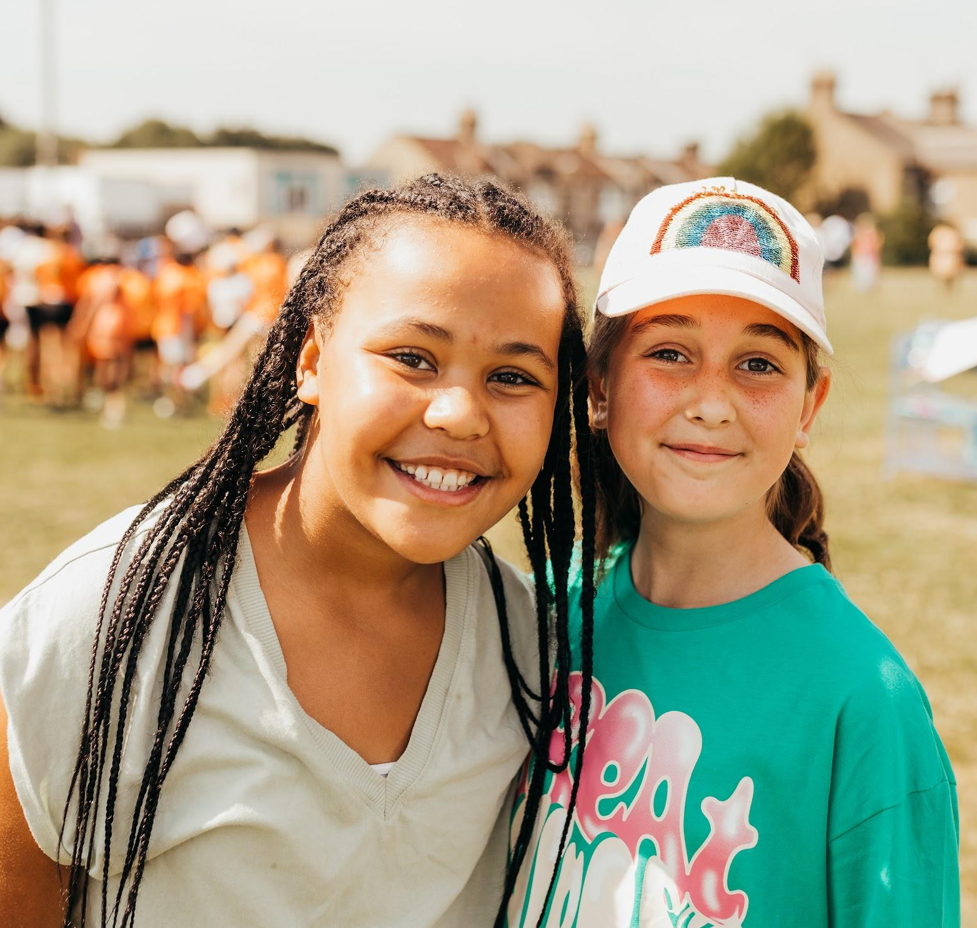

Slide 6
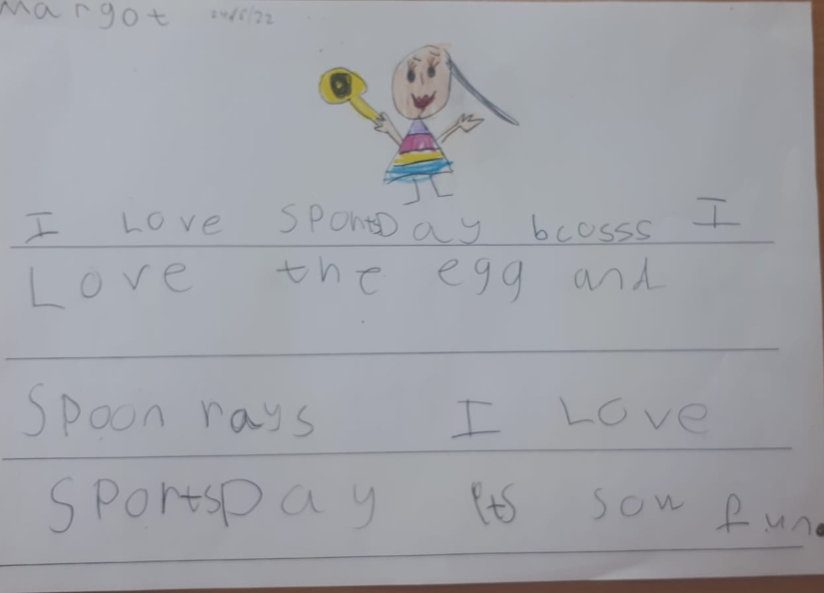
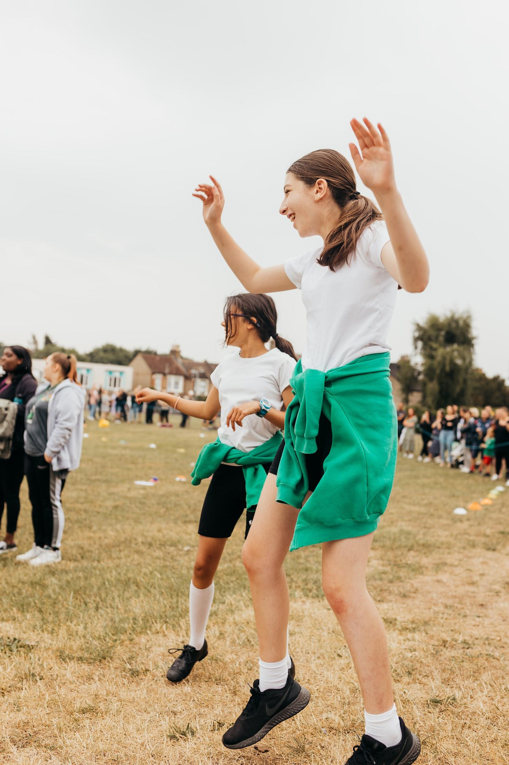
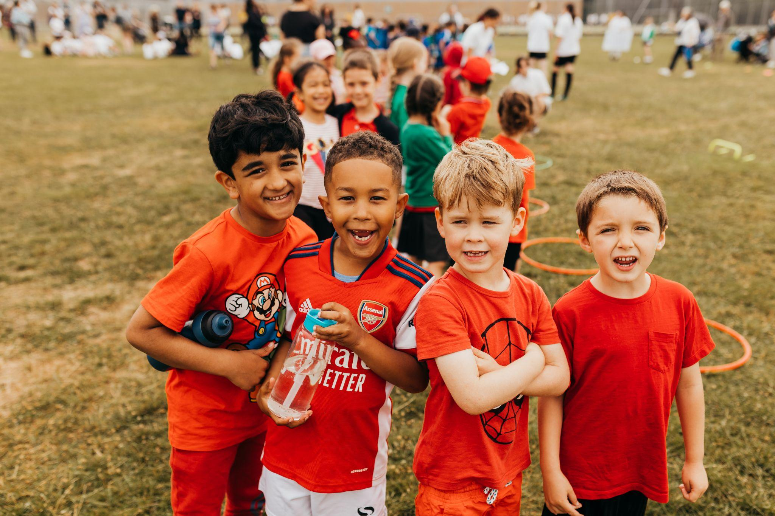
Thank you once again Ms Davey for the fantastic pictures! We look forward to sharing more with you soon!
Reception loved writing about Sports Day!

Slide 7
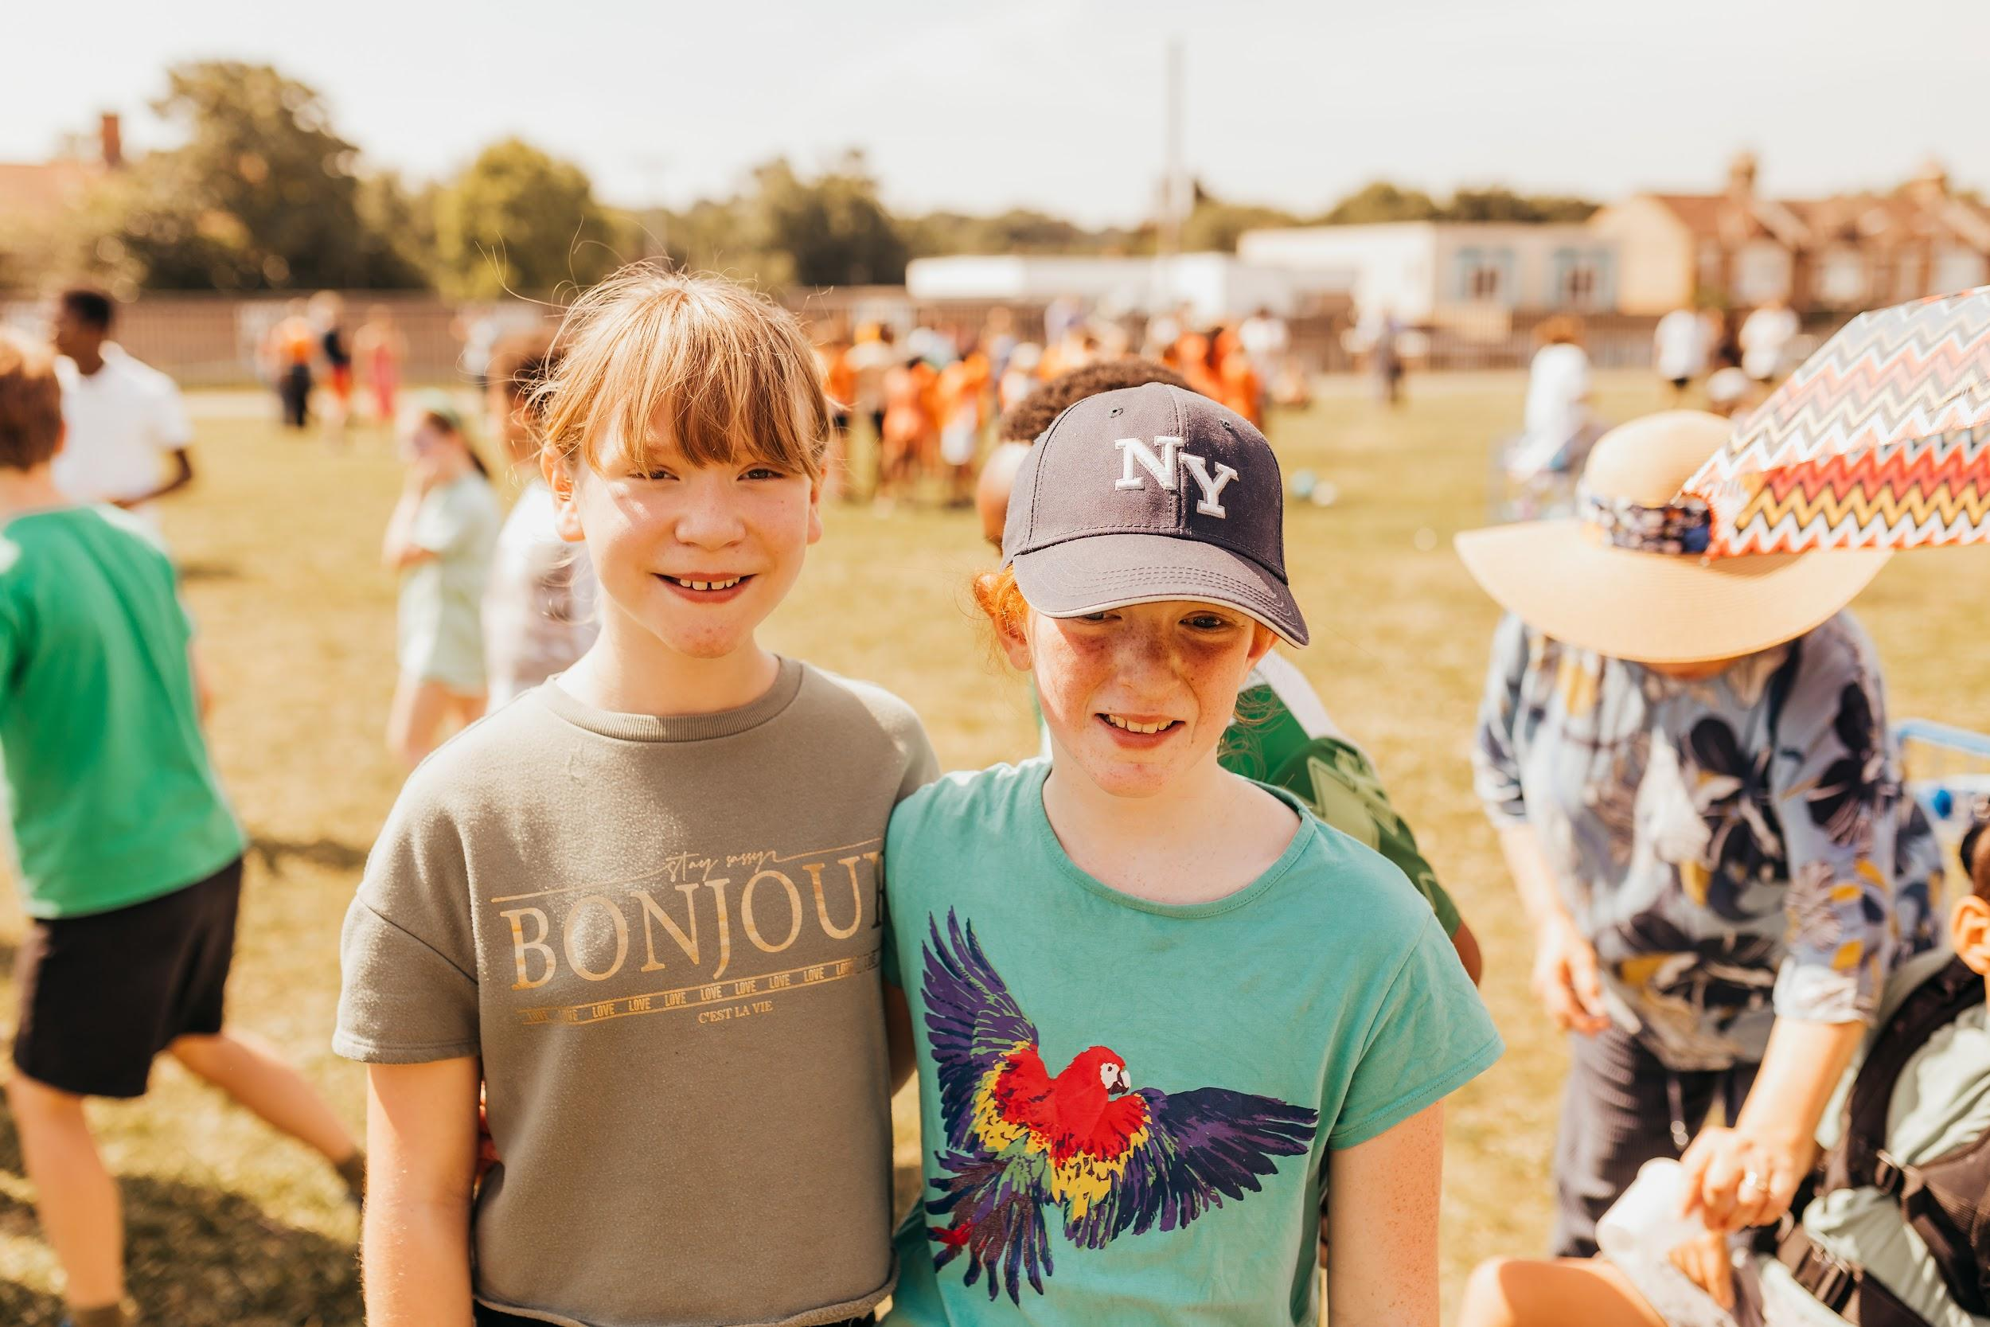
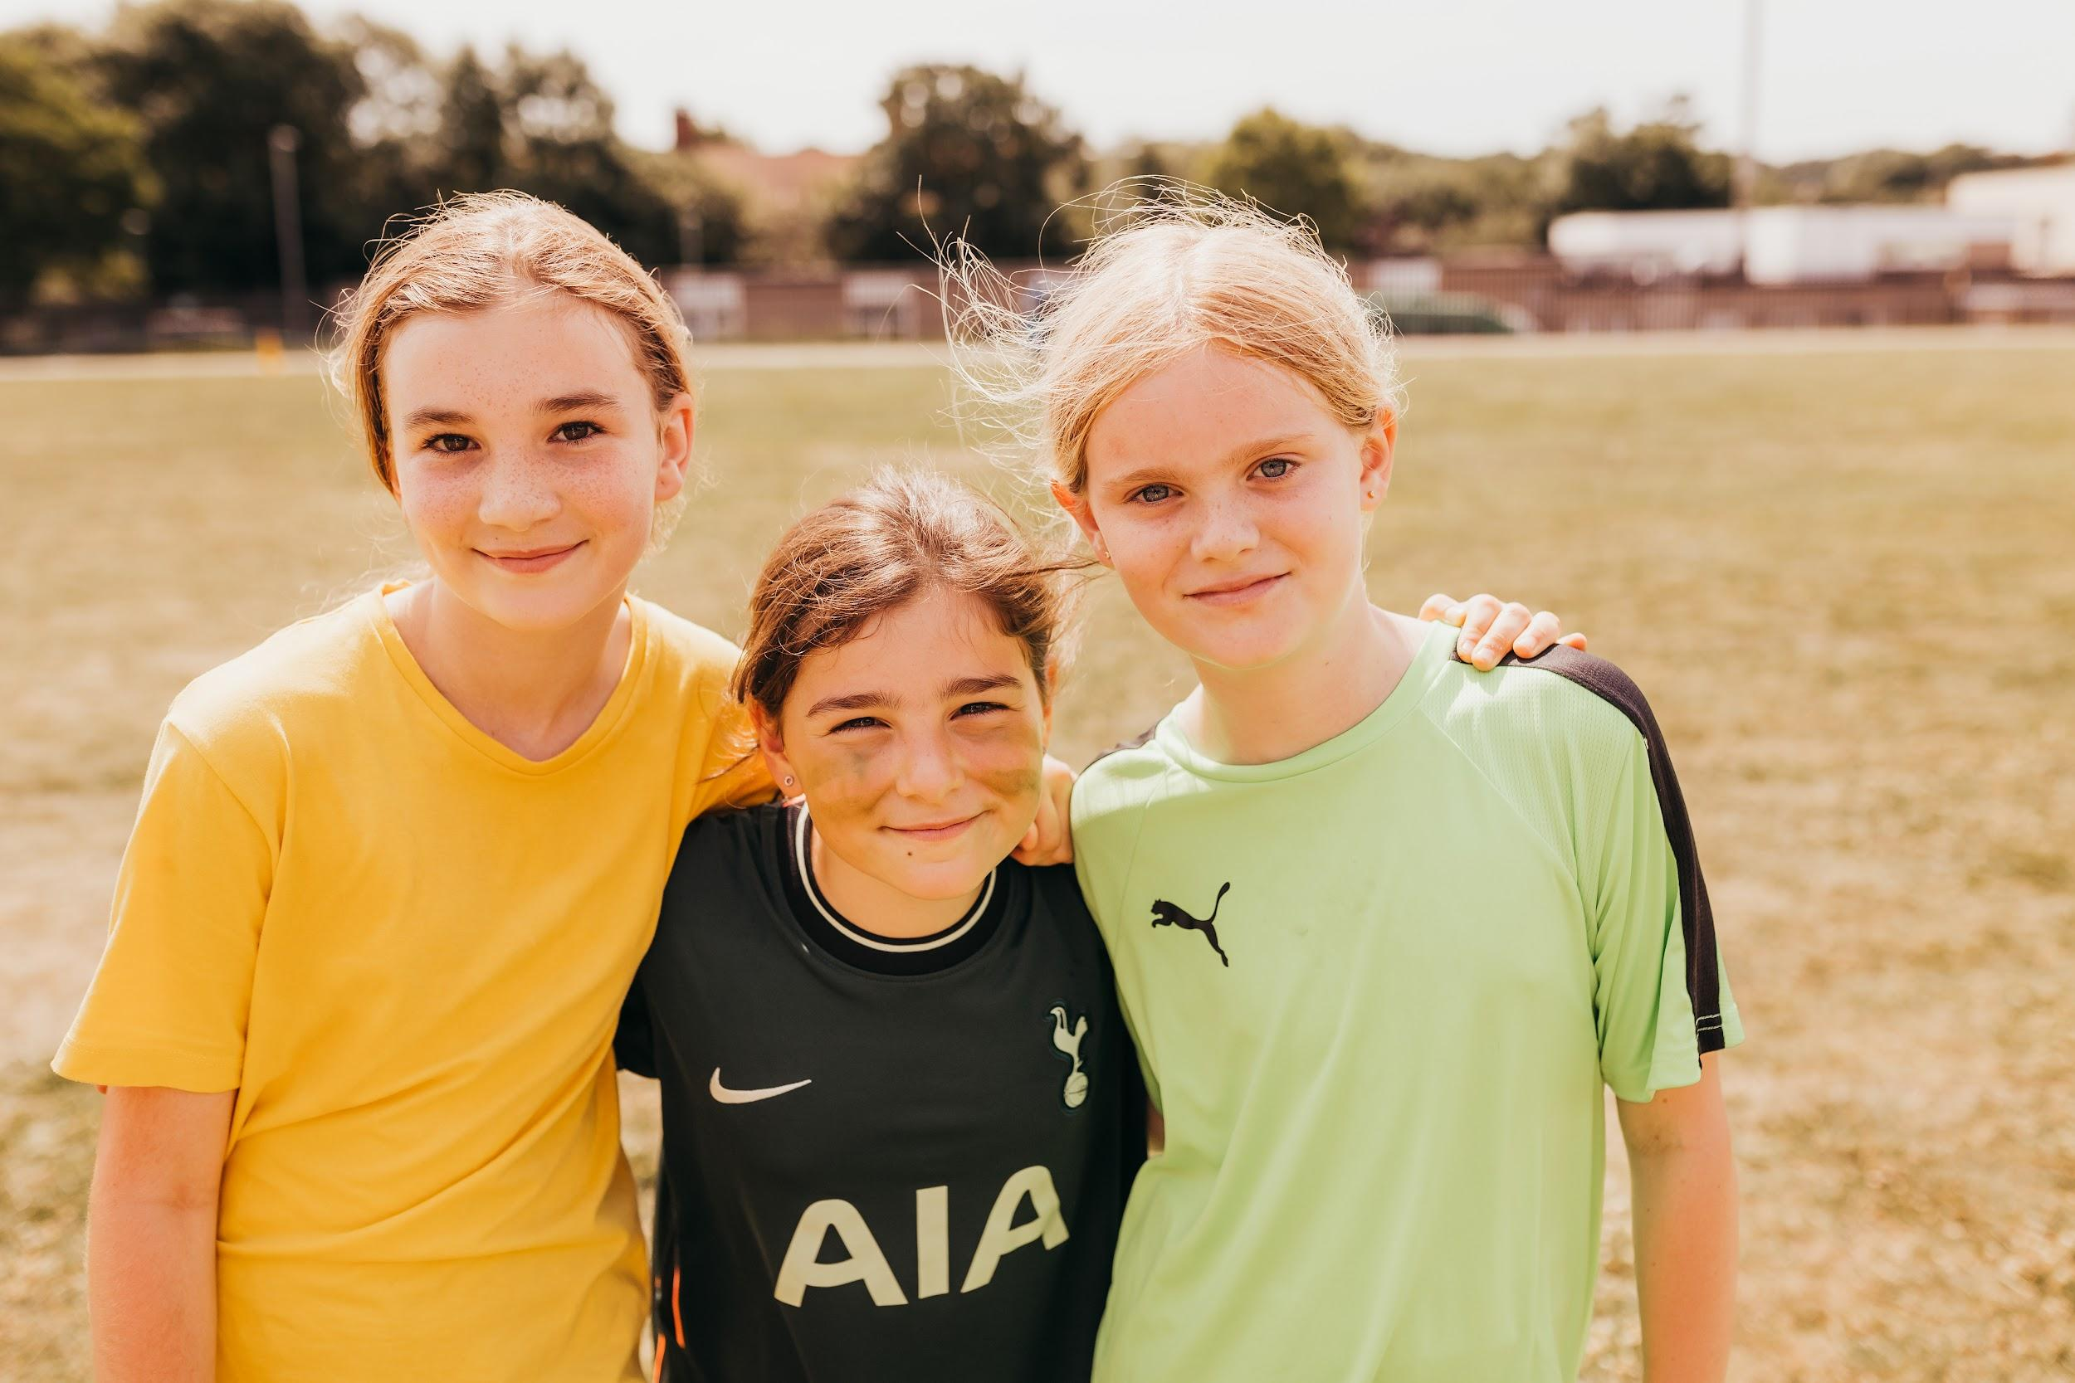
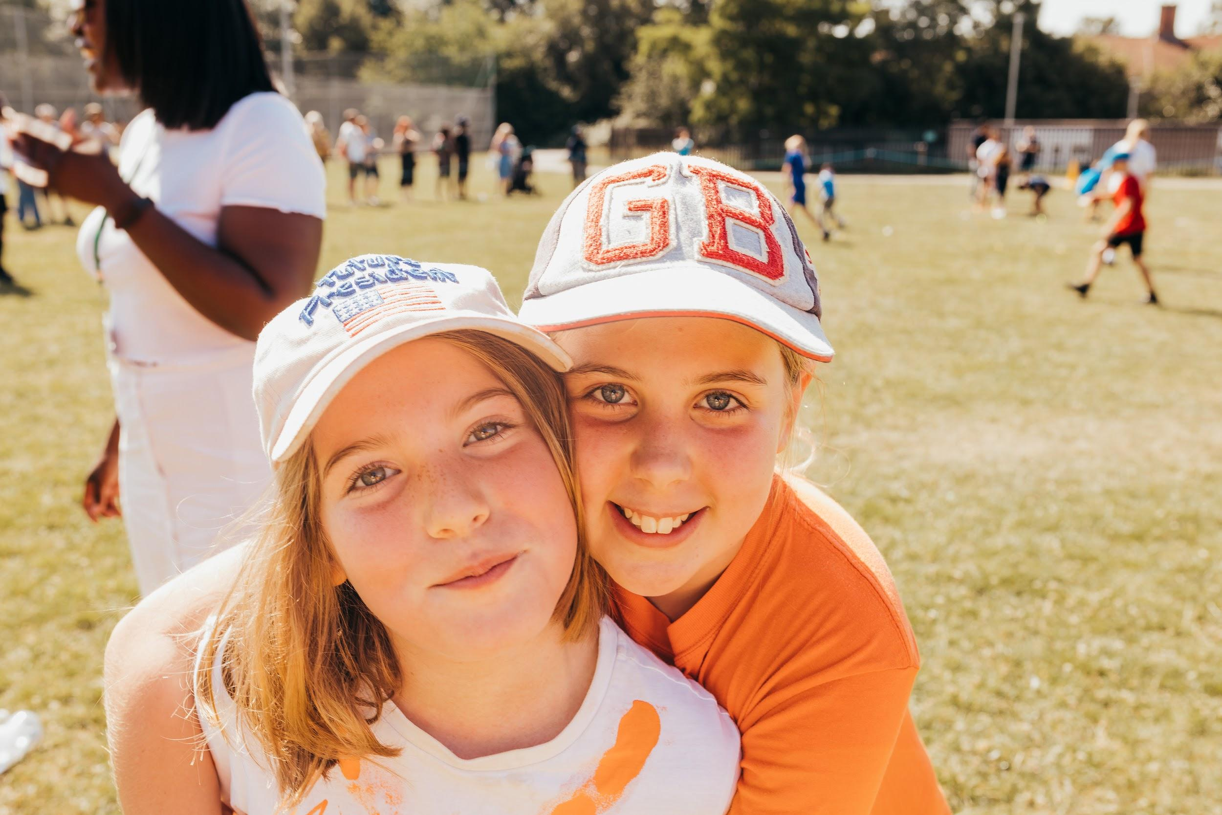
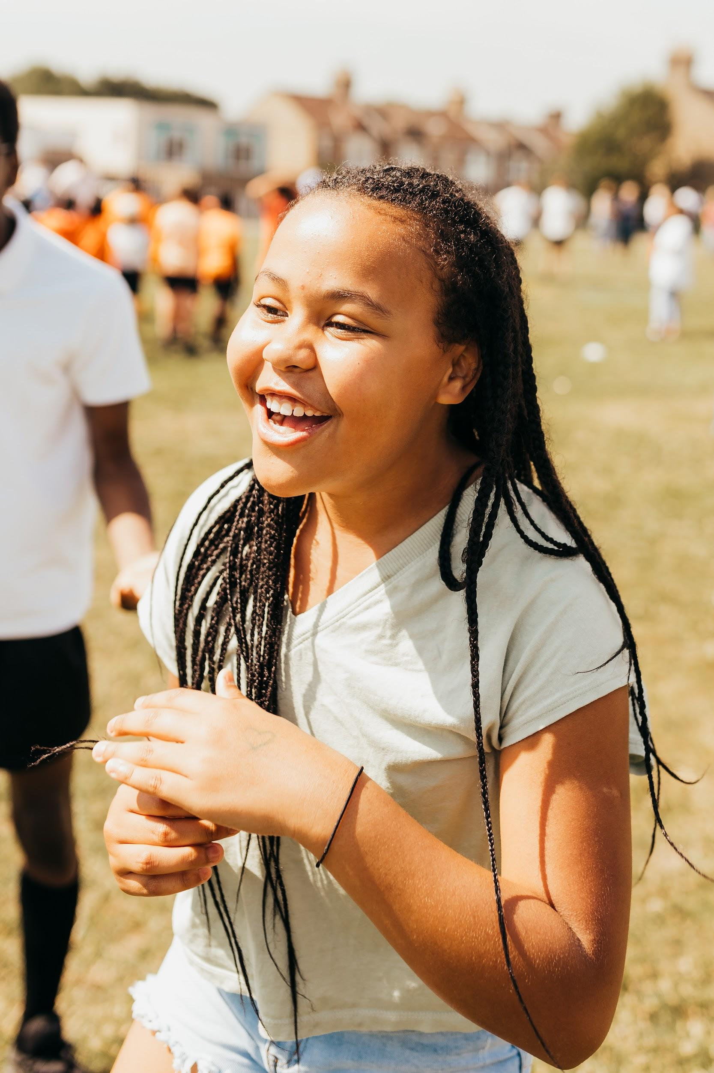
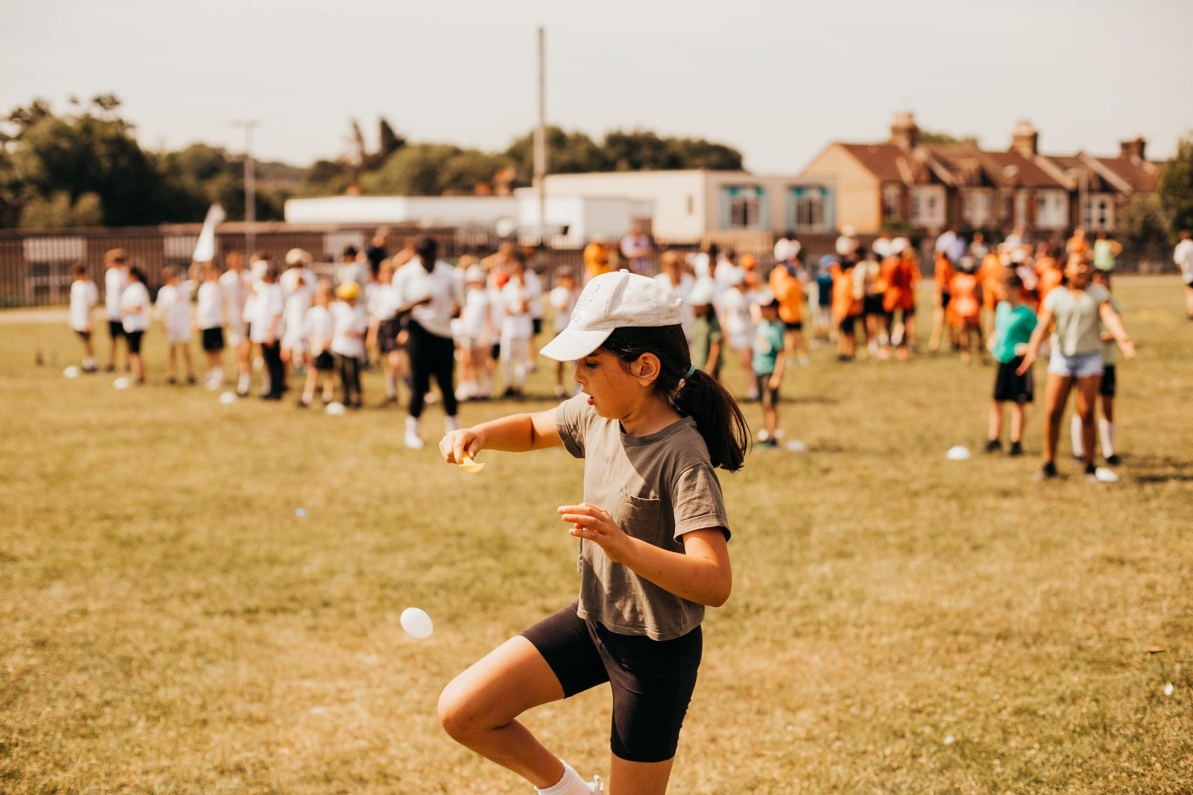
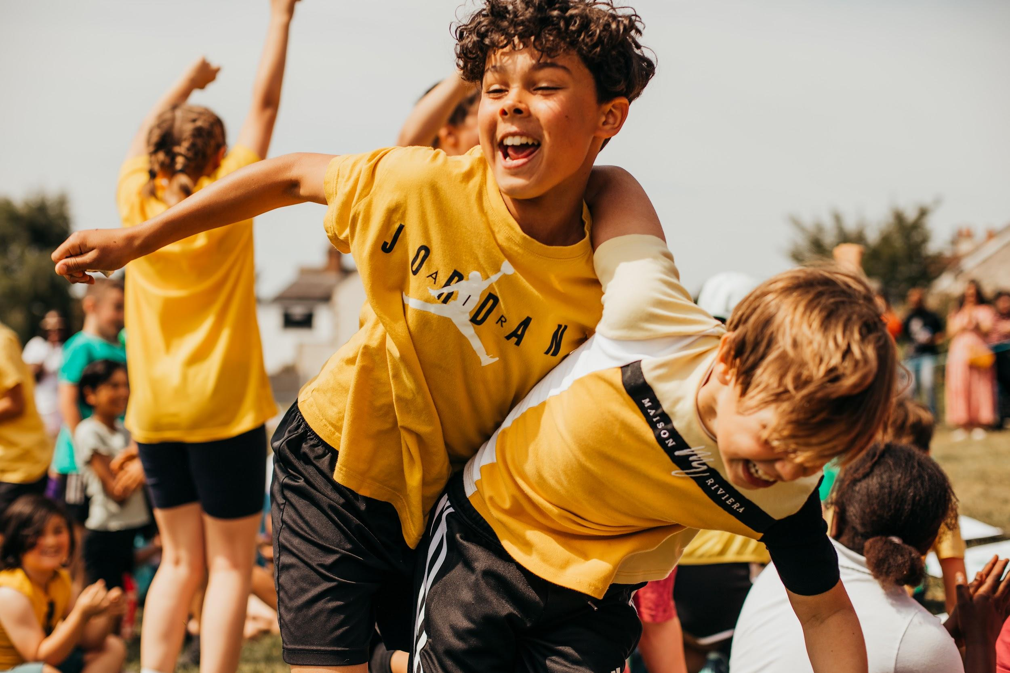

Slide 8
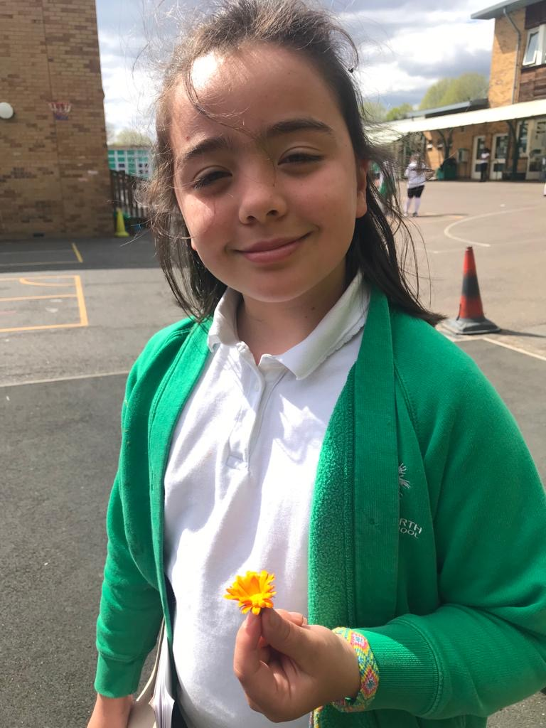
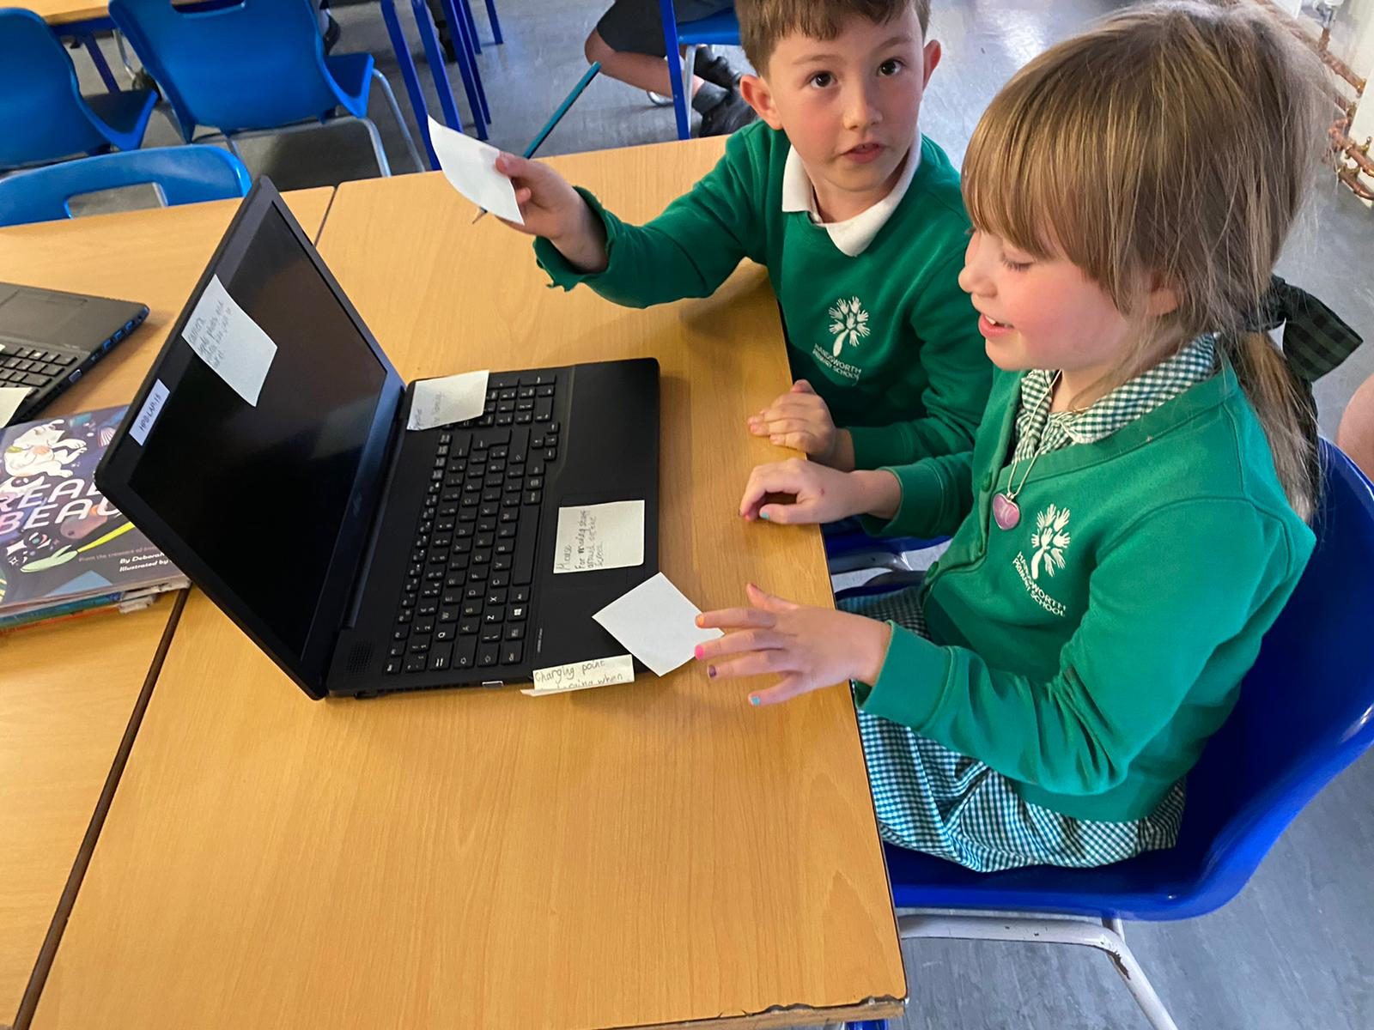
Dates | Events
Saturday 2nd July 2022 11am to 5pm | FOH Summer Picnic
Friday 8th July 2022 | Year 6 Production
Monday 11th July 2022, 2-3pm | School Nurse Drop in Session
Wednesday 13th July, 3.45-5pm | Open Classroom
Friday 15th July 2022 | Bank holiday - Queen's Platinum Jubilee
Thursday 21st July 2022 6pm | Year 6 Graduation
Friday 22nd July 2022 2.30pm | End of Term
Friday 22nd July 2022 2.30pm | FOH Krispy Kreme Sale
Monday 25th July 2022 | INSET day - School Closed
Thursday 1st September 2022 | INSET Day - no students in school
Friday 2nd September 2022 | INSET day - no students in school
Monday 5th September 2022 | First day of term for students
Friday 7th October 2022 9am | FOH AGM
Friday 21st October 2022 7.30pm | FOH Quiz Night
Saturday 26th November 11am to 4pm | FOH Christmas Fayre
Friday 16th December 2022 | FOH Krispy Kreme Sale
20th February - 24th February | Year 4 Swimming Lessons - 4FB
27th February - 3rd March | Year 4 Swimming Lessons - 4JG

Slide 9
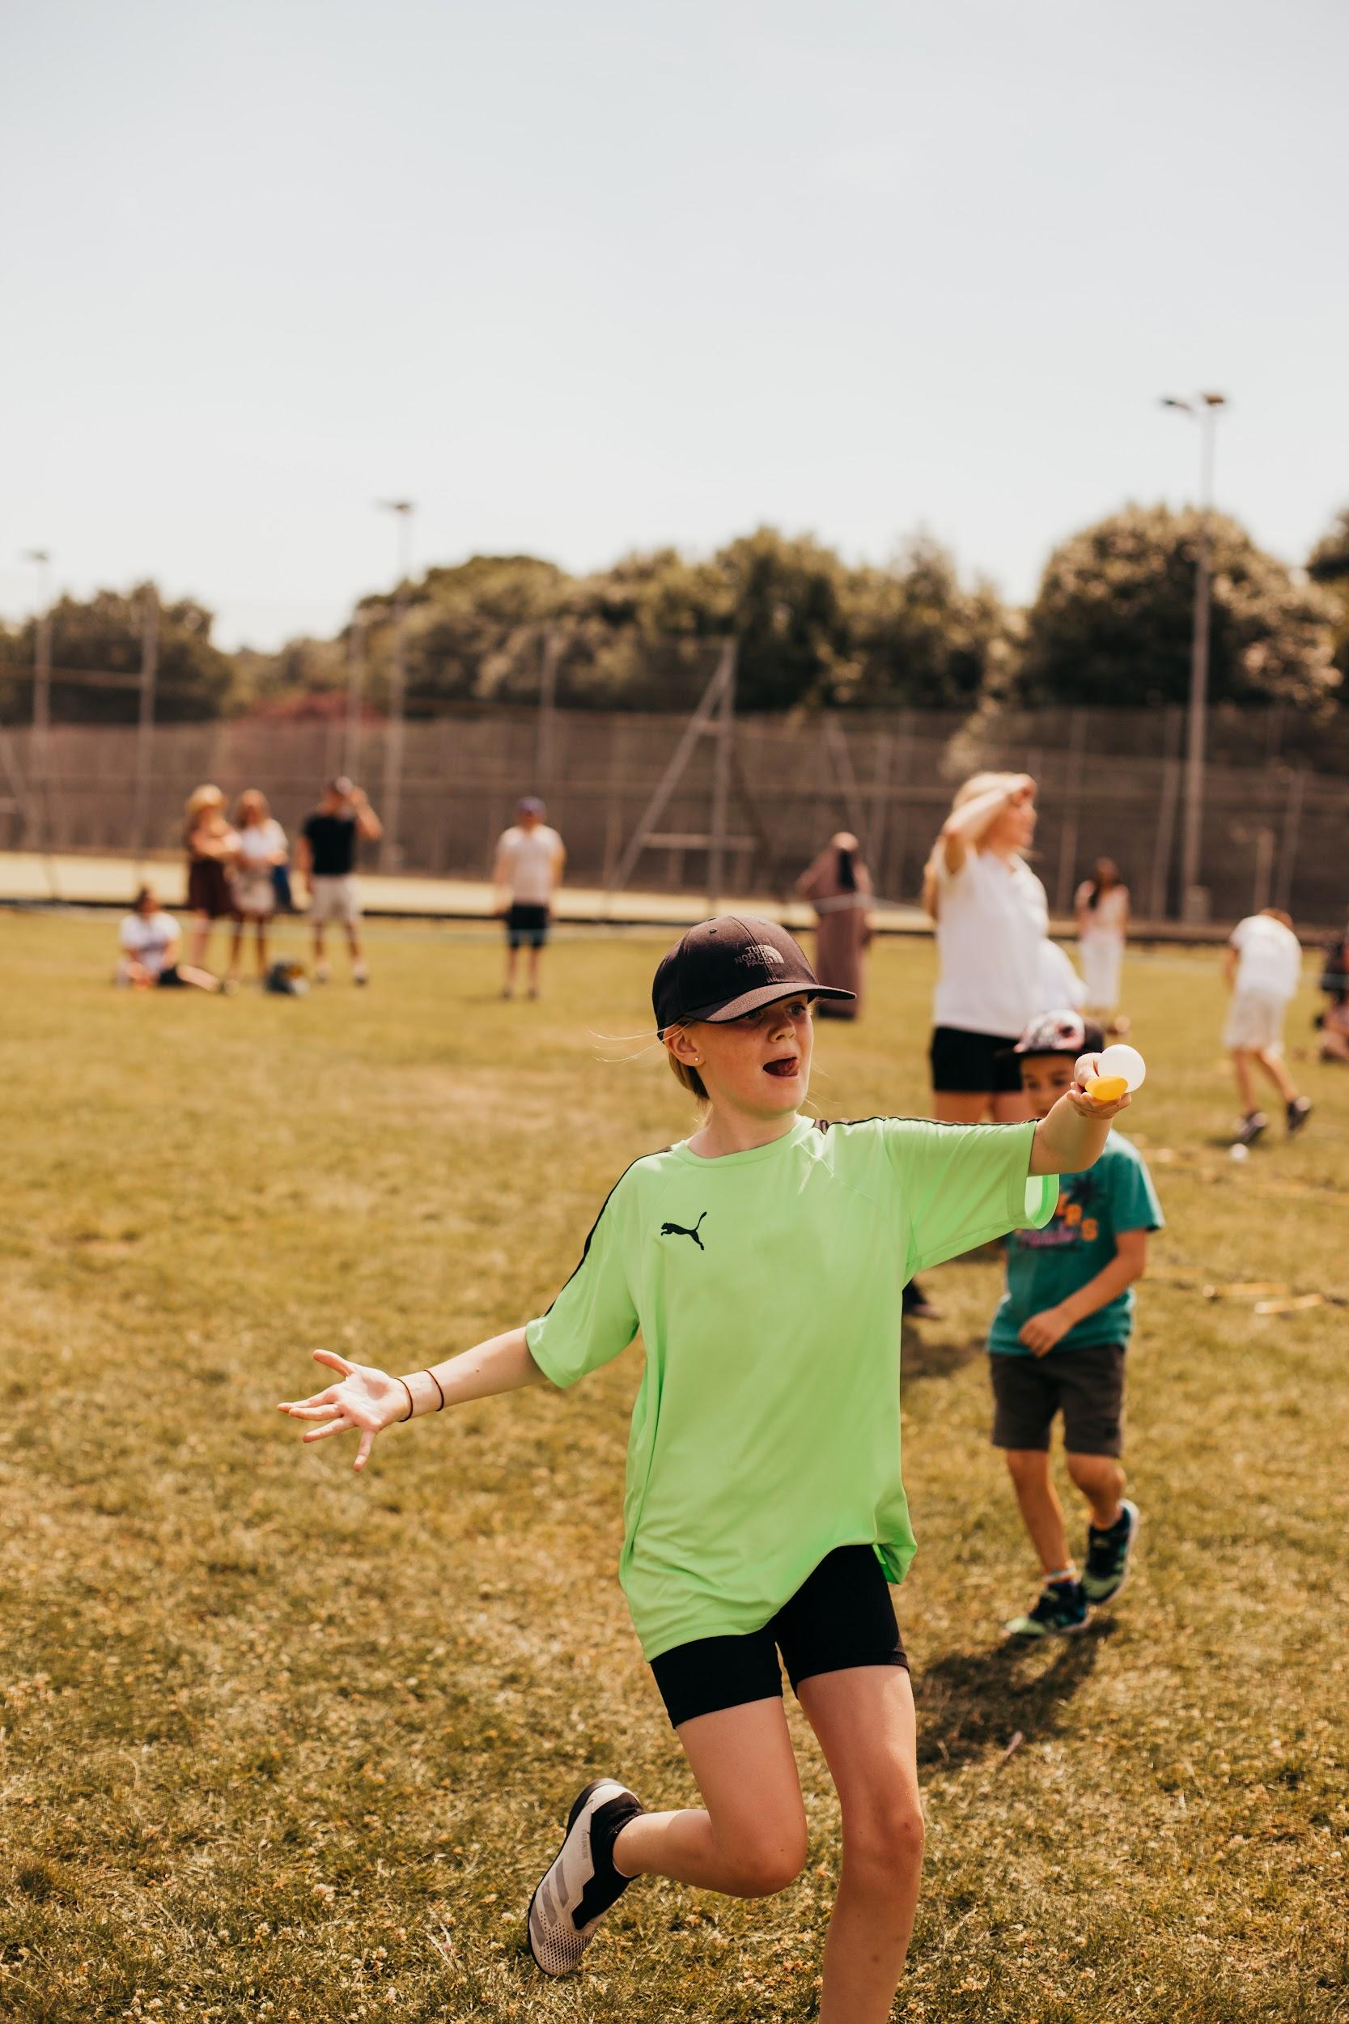
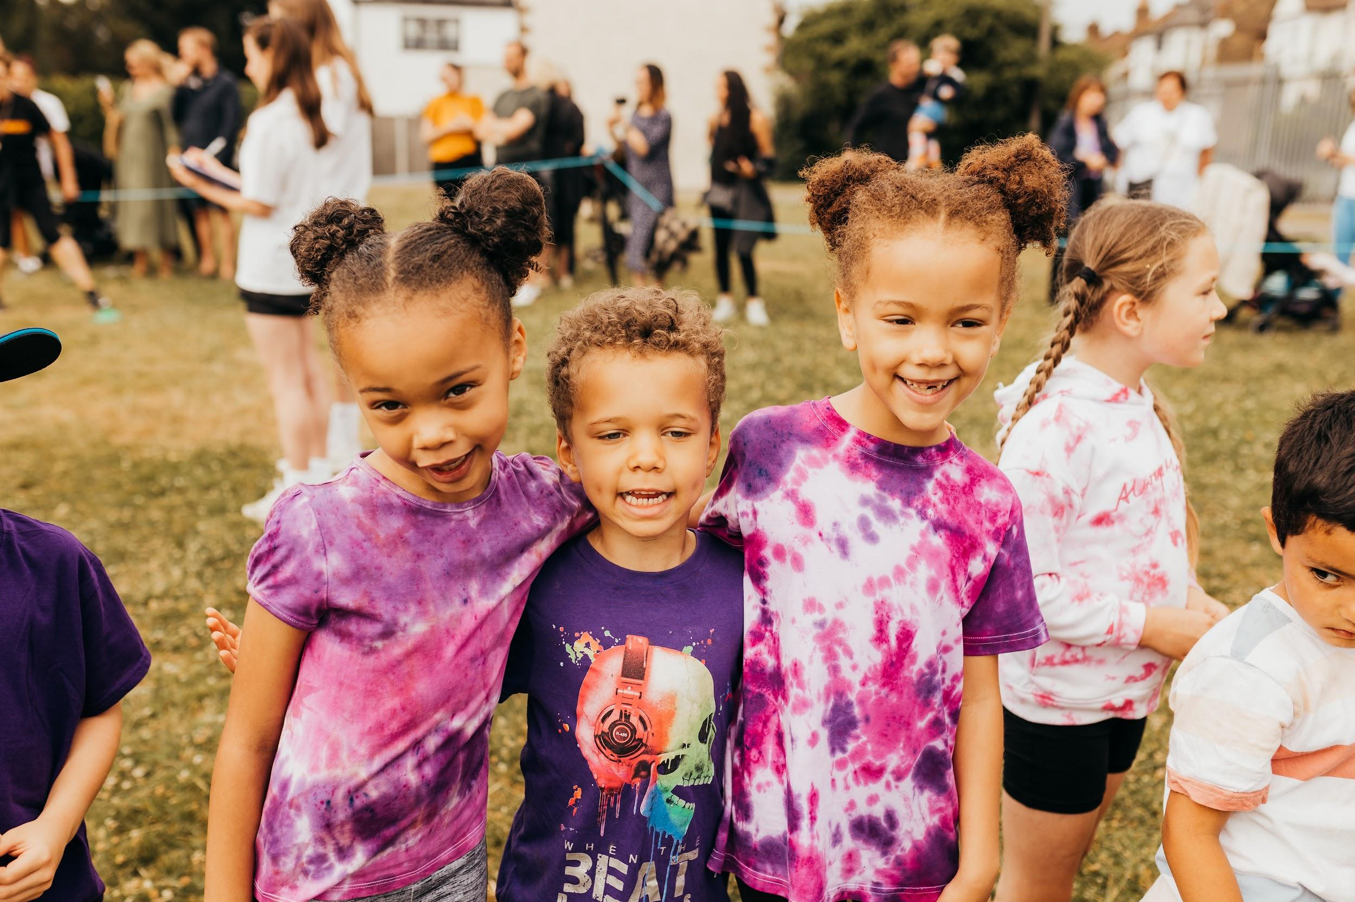
Transition
As part of our transition process, we have made a google form on which you, as parents and carers, can inform us of anything you would like next year’s teacher to know. Please click here to access the form. Please note, we will not always reply to these comments but class teachers will read them.
Please contact the school office if you would like to sponsor Leon!

Slide 10
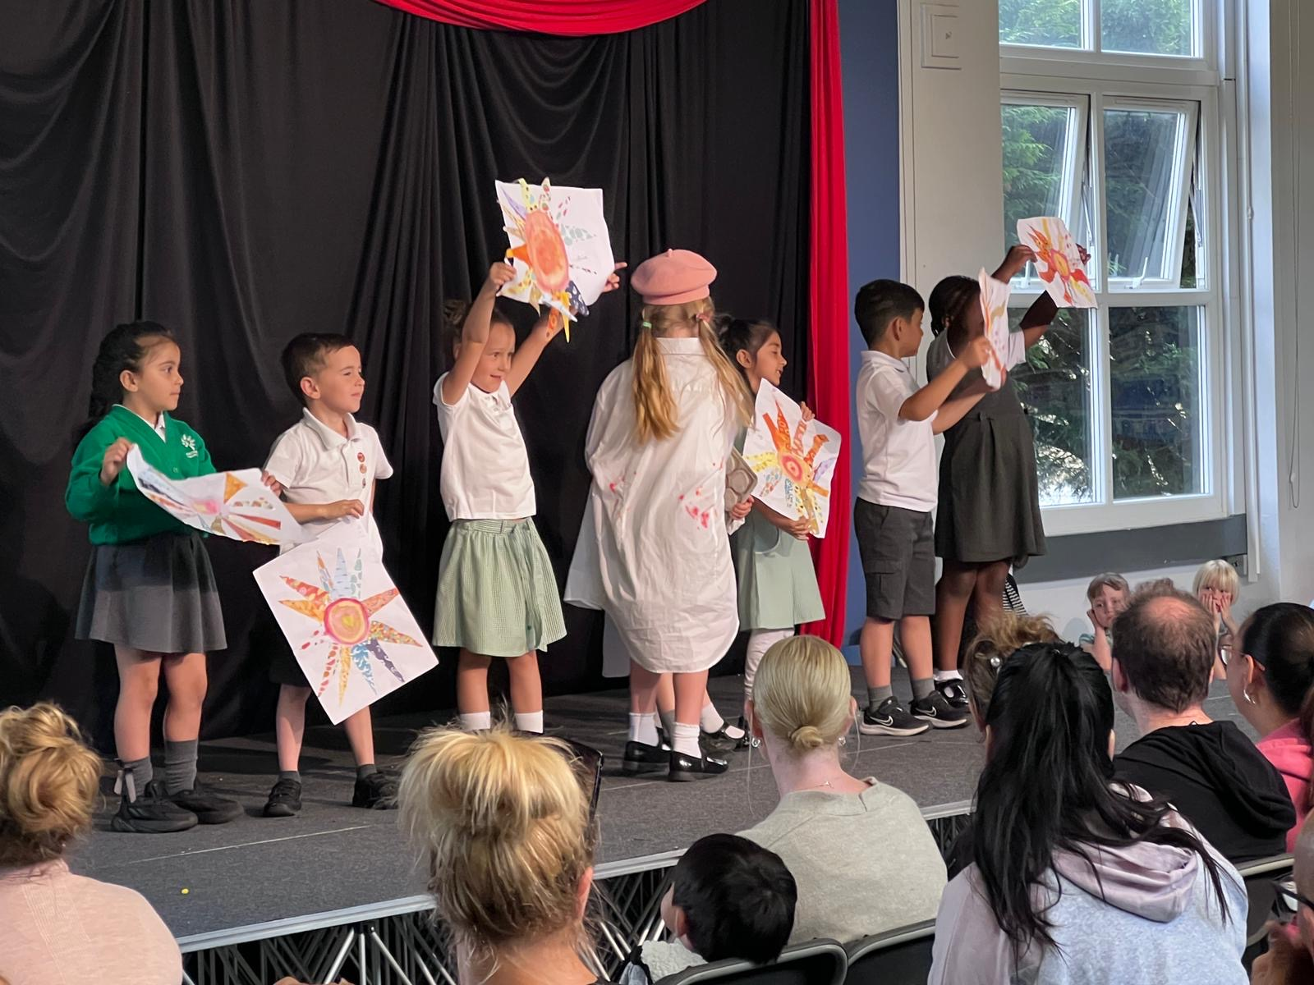
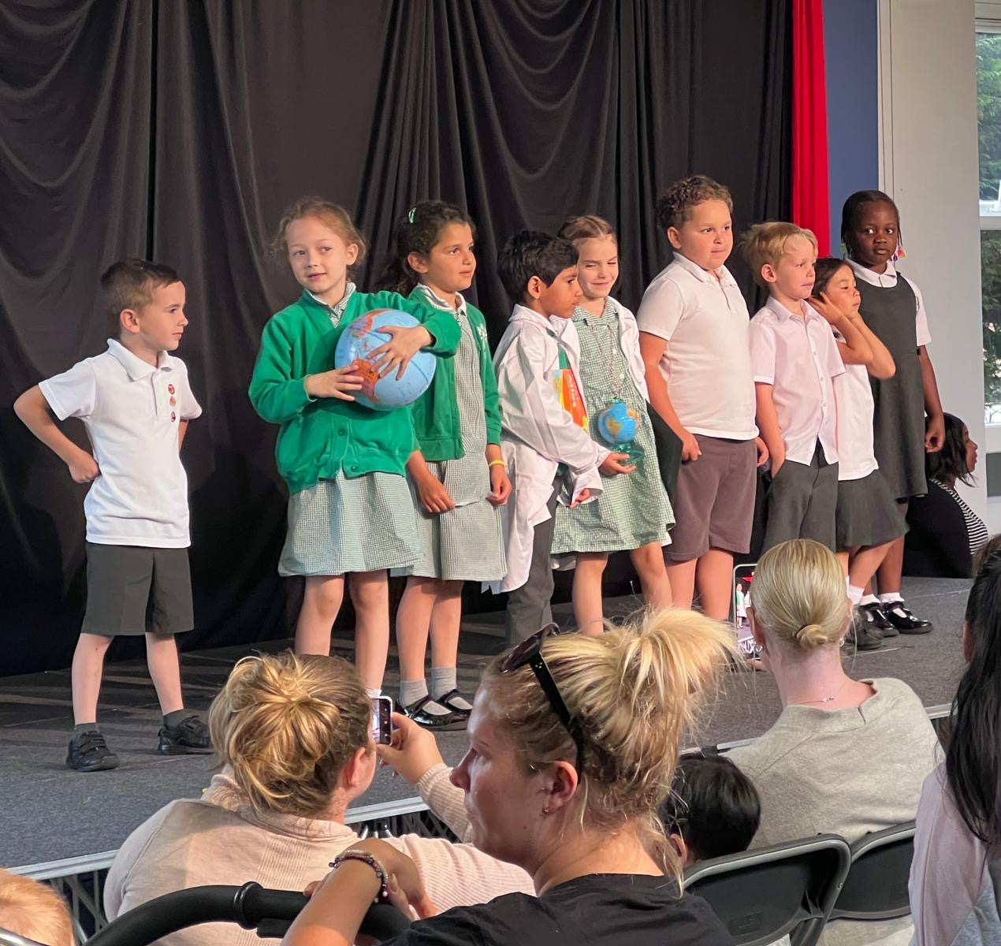
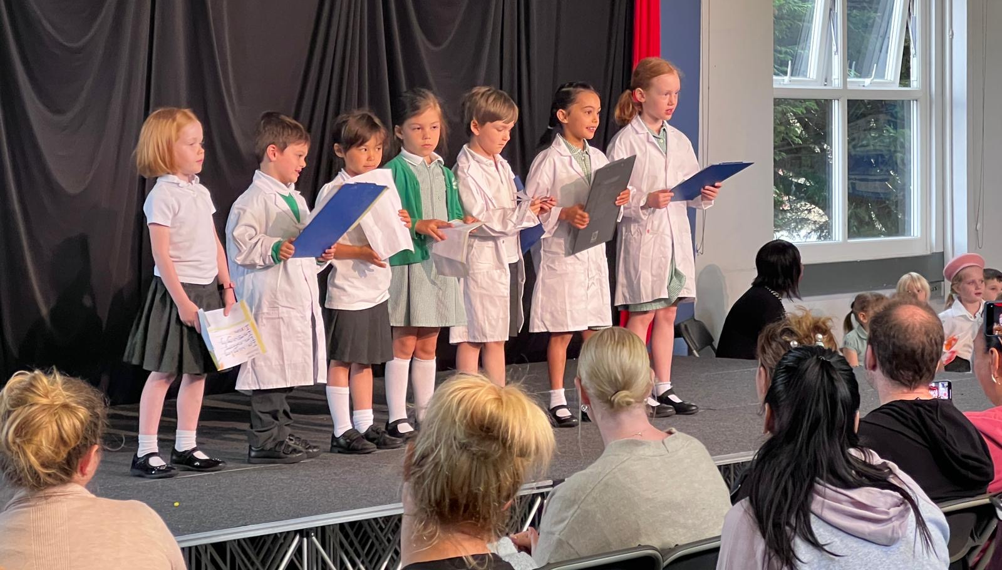
Well done Year 1 and Year 5! We are so proud of you!

Slide 11
Woodford Rugby Club is promoting girls rugby!
They will be hosting a Yr 5 Girls Touch Rugby session on Wednesday 6th July between 6.30-7.30 at the club.
This will be taking place alongside the clubs main U12s-U18 girls session on that day.
The invite is open to all current Yr 5 girls (but could open to younger girls if keen), so please spread the word! No Rugby experience necessary. It will be an informal session with NO contact. Just fun drills and games. The more girls there the better!
Depending on the success, we may look to continue in the summer
Parents and carers, please do not to allow children to bring in Pokémon cards to trade in school. This is causing upset as cards are going missing .The children were told they are not allowed to bring them but some have been sneaking them in their pockets and taking them into the playground.
Please always make sure you are aware of the apps and games your child is playing online. It is important to have regular discussions about how the children are using the internet and the importance of keeping safe online. Please let us know if you would like to discuss further.

Slide 12
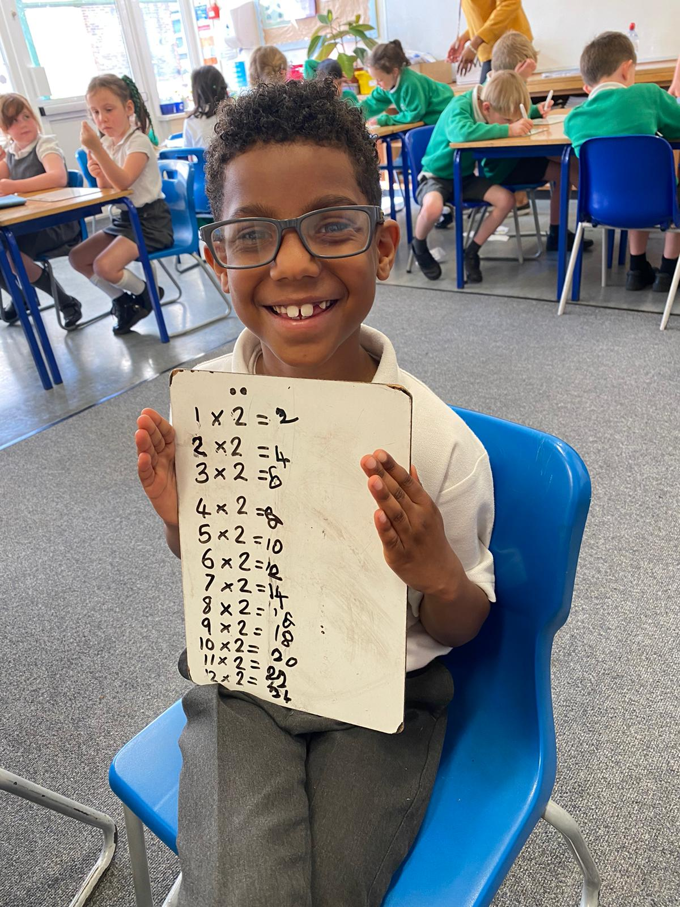
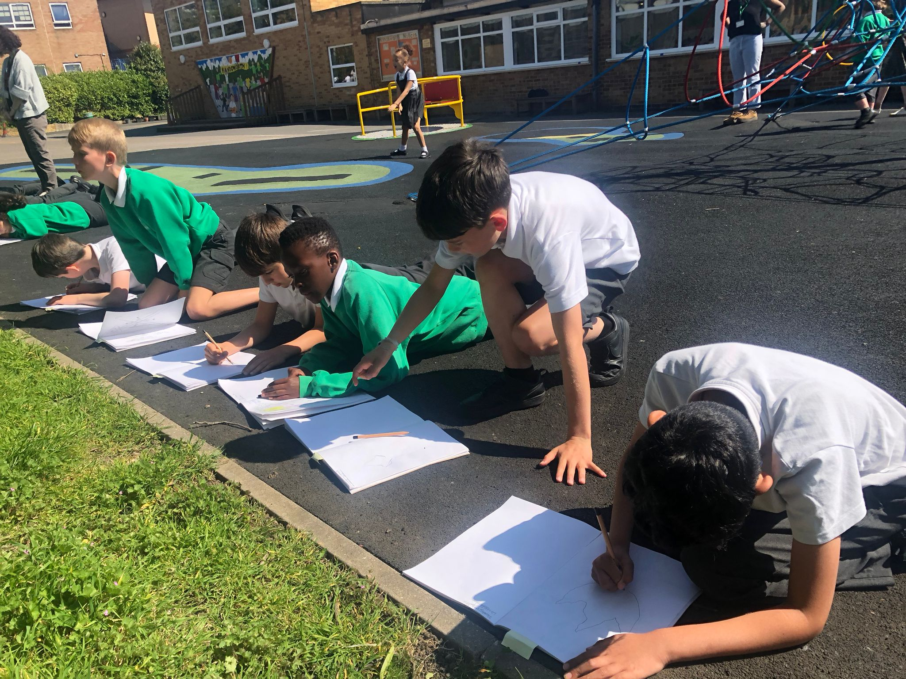
Teaching is the best job in the world! If you want to train as a teacher, you are welcome to train with us! Please click on this link to find out more.
If you are wondering if teaching is for you, then you are more than welcome to come and volunteer in our classrooms and see the joy that teaching brings!
We are ALWAYS looking for volunteers!

Slide 13
CLICK HERE!
CLICK HERE!
CLICK HERE!

