Slide 1
WATER AID!
Jerome Akinola ,Noah wheeler, Benito Crosara

Slide 2
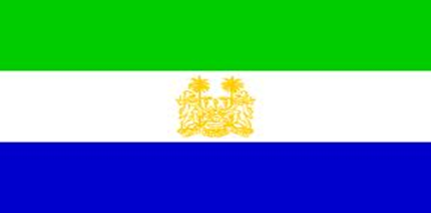
SIERRA LEONE
Providing toilets and access to safe water are especially challenging as Sierra Leone suffers from regular flooding. Only 11 per cent of Sierra Leoneans currently have access to improved sanitation facilities, and only 53 per cent use improved water sources. Lack of sanitary facilities and poor hygiene are also contributing factors to Sierra Leone’s exceptionally high mortality rate among children under the age of five.

Slide 3
MORE ABOUT SIERRA LEONE
2.6million people in Sierra Leone don't have access to safe water. This is nearly half of the population. Over 4,000 children die every year from diarrhoea caused by unsafe water and poor sanitation in Sierra Leone. Sierra Leone emerged from a decade-long civil war in 2002 but the country still faces many challenges.

Slide 4
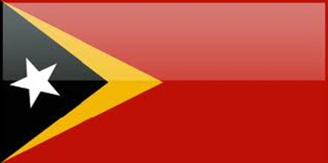
TIMOR-LESTE
Nearly a third of the population have no choice but to collect dirty water from unsafe sources. This has serious health impacts; 12% of children die before the age of five.

Slide 5
MORE ABOUT TIMOR-LESTE
People in Timor-Leste don't have access to safe water; nearly a third of the population.
610,000 people don't have access to adequate sanitation in Timor-Leste, nearly two thirds of the population. Over 160 children die every year from diarrhoea caused by unsafe water and poor sanitation in Timor-Leste.

Slide 6
THANKS FOR WATCHING

