Slide 1
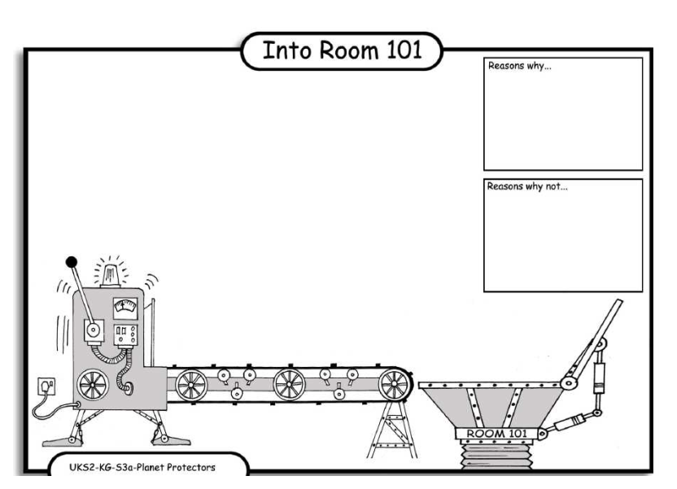
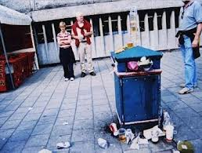
LO: Debating. 4.10.2013 Zaki and Jeyda
Reasons why:
Reasons why:
Some litter can
Be rscold.
Reasons why:
Litter hurts the wold.
Reasons why:

