Slide 1
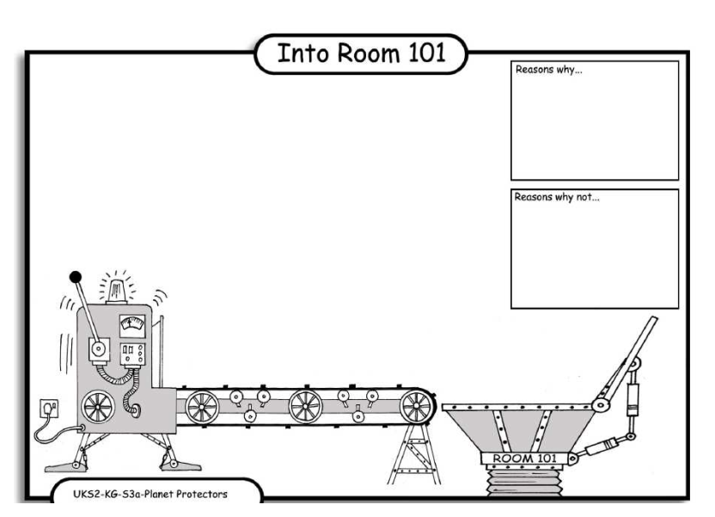
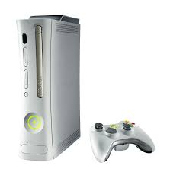
LO: Debating. 4.10.2013 Egehan and Saffron
Reasons why:
An x boxs wastes elctriste.
Reasons why:
If there were no x boxs then childrin will get more exercise.
Reasons why:
If you don’t have an x boxs then you can play with all your other toys.
Reasons why
Its very ecspensive .

Slide 2
