Slide 1
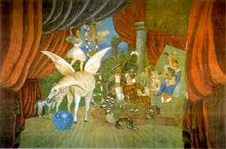
Take one Picture
Numeracy
Literacy
3JP
History
Music
Art
‘The Parade’ by Pablo Picasso

Slide 2
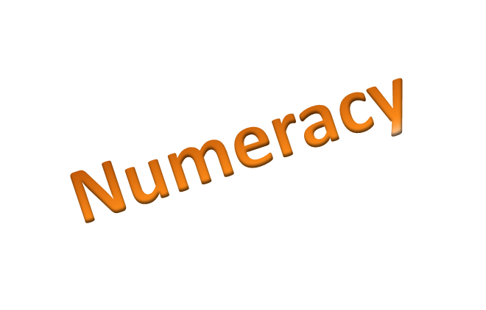
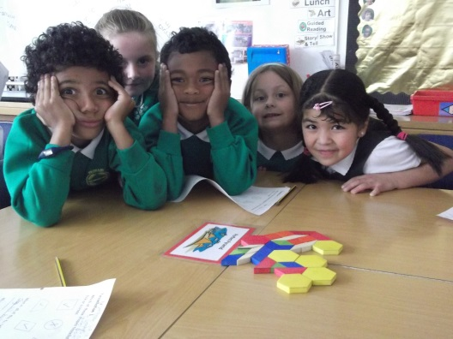
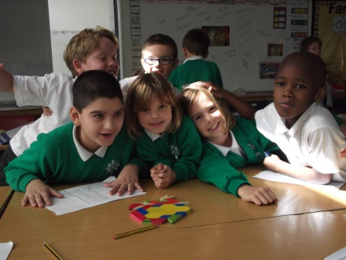
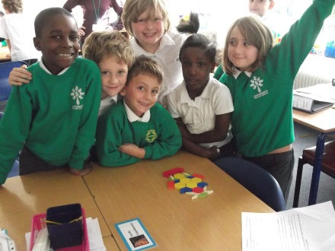
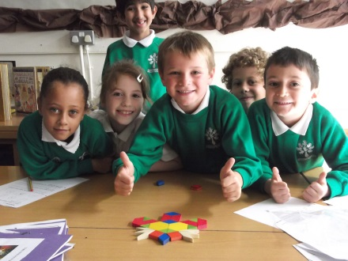
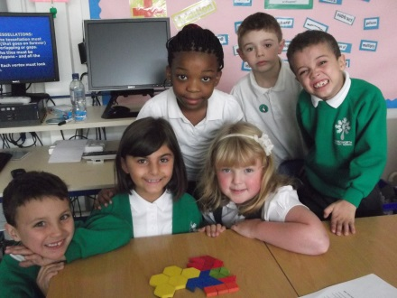
Take one Picture
We decided to focus on pattern and tessellation during numeracy as we identified some in the picture.
We really enjoyed making tessellations. A tessellation is when shapes fit together leaving no gaps.
We looked at patterns and where they could be found we found many in our classroom.
‘The Parade’ by Pablo Picasso

Slide 3
Take one Picture
Literacy
We thought about who the characters might be and what they might do.
We chose some of the characters to include in our stories.
Some of the characters we thought of were: A fairy, Pegasus, Joker, King, Queen, Goblin king and many more.
‘The Parade’ by Pablo Picasso

Slide 4
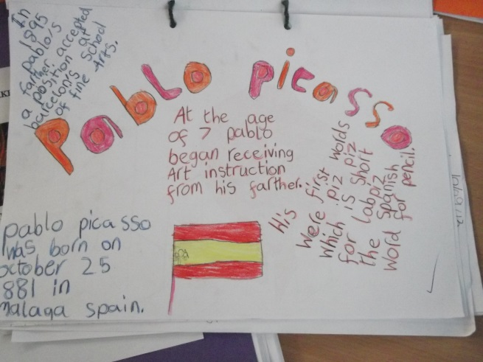
Take one Picture
History
We did some research about Picasso.
He was born in Spain but spent most of his life in France.
His first word was pencil!
Did you know he was born in 1881?
‘The Parade’ by Pablo Picasso

Slide 5
Take one Picture
Music
We also listened to a piece of music by a composer named Erik Satie. He wrote a piece about Picasso’s Parade.
While we were listening we thought about specific sounds that helped us imagine each character in the picture.
We wrote verses to a song we had been learning using the animals and characters in Picasso’s picture to help with our ideas.
‘The Parade’ by Pablo Picasso

Slide 6
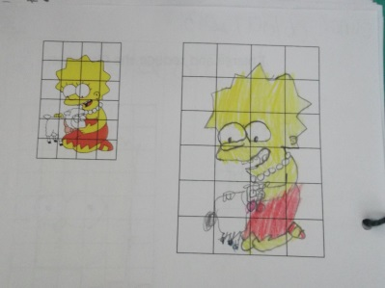
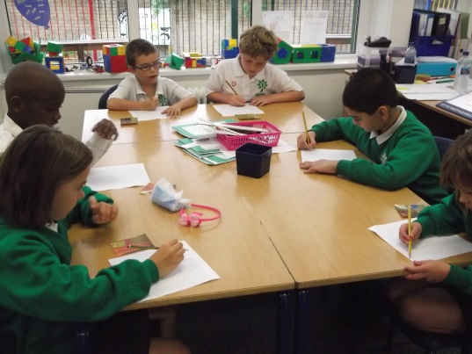
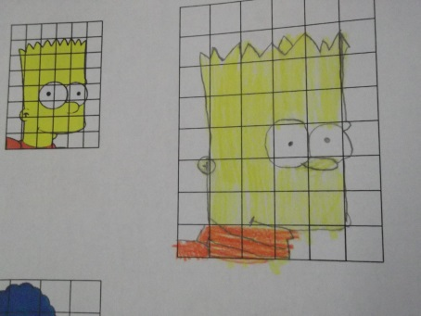
Take one Picture
First we practised enlarging characters from the Simpsons.
We had to think carefully about the scale of our drawings.
We worked in groups to enlarge the picture. We each had one section of the picture to focus on.
We then chose different techniques to complete our picture. E.g. Pencil, paint, pastels or collage.
‘The Parade’ by Pablo Picasso

Slide 7
Take one Picture
I’m sure you’ll agree we worked really hard during our first week back!
The children’s folder of work will be coming home very soon!
‘The Parade’ by Pablo Picasso

