Slide 1
Water Aid
A presentation
by Joseph, Harry and Alex.

Slide 2
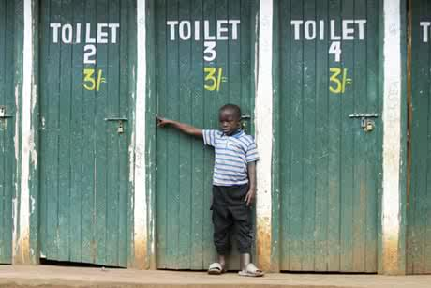
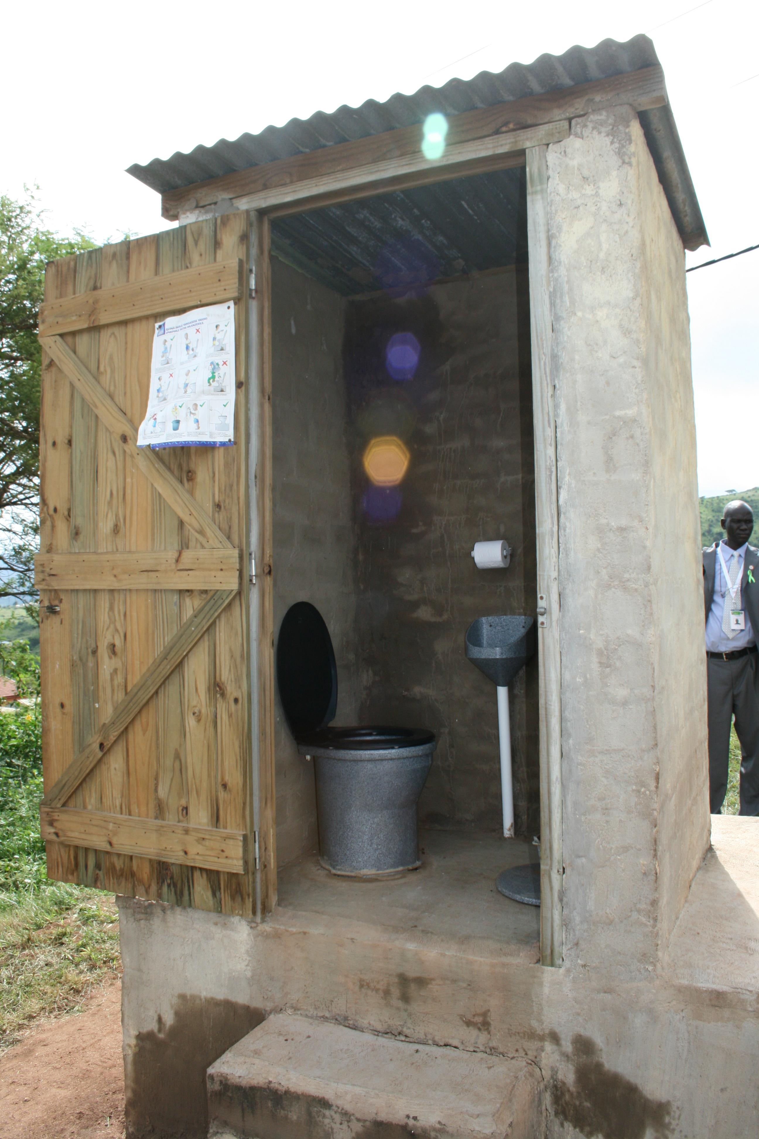
What Water Aid Do
Founded in 1990, Water Aid are a hard-working charity which tackle crisis from all areas with local partners to deliver services from wells to toilets to make changes happen.
They generate wonderful support across to unfortunate countries around the world.

Slide 3
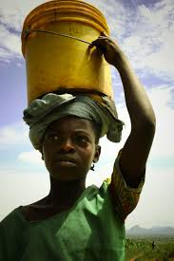
Water Crisis
A country Water Aid help is Ethiopia.
In the country, 43.4 million people don’t have access to clean water and this is over half of Ethiopia’s population.
People in this area have no choice but to collect dirty water from wells and unsafe lakes and rivers.
Because of this, around 33000 children die each year of diseases.

Slide 4
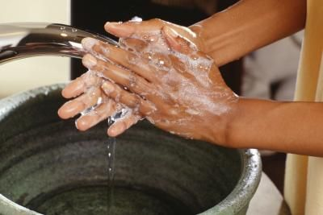
Hygiene Problems
When poor hygiene is all around , water-related diseases spread fast.
If children and adults had the right to wash their hands with soap and water after going to the toilet and before preparing food or eating, they could avoid life threatening water-related diseases.
Hand-washing could cut the risk of diarrhoea in almost half.

Slide 5
Water Aid’s Aim
Water Aid try and bring together as many people together as possible – with supporters, local communities , businesses and service providers – they have a better chance of getting the change we want.
Water Aid has incredible support, and communities campaign across the world, helping to keep the water and sanitation crisis at the top of the agenda.

Slide 6
How We Can Help
To help, we could have cake sales to raise money or have a special day to do this. We could save much more water by turning off taps when not using them. Also we could ask people to donate unwanted clothes and toys and the money for the toys and clothes will go to charity.

Slide 7
Thanks For Watching!
From Harry, Joseph and Alex.

