Slide 1
Water Aid Kenya
By Kiera & Surrayah & Jade

Slide 2
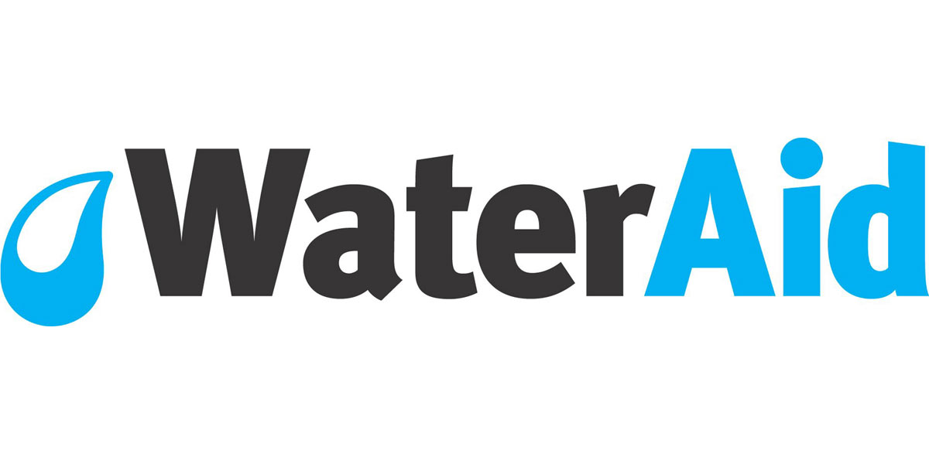
This is the Water Aid sign…

Slide 3
What is the issue… The issue is that
16 million Kenyans still lack access to safe water. This has a huge impact on health and infant mortality.
29^{M}
Over 29 million people don't have access to adequate sanitation in Kenya, over two-thirds of the population.

Slide 4
What is affected… the things that is affected?
16 million Kenyans still lack access to safe water. This has a huge impact on health and infant mortality

Slide 5
How can we help?

