Slide 1
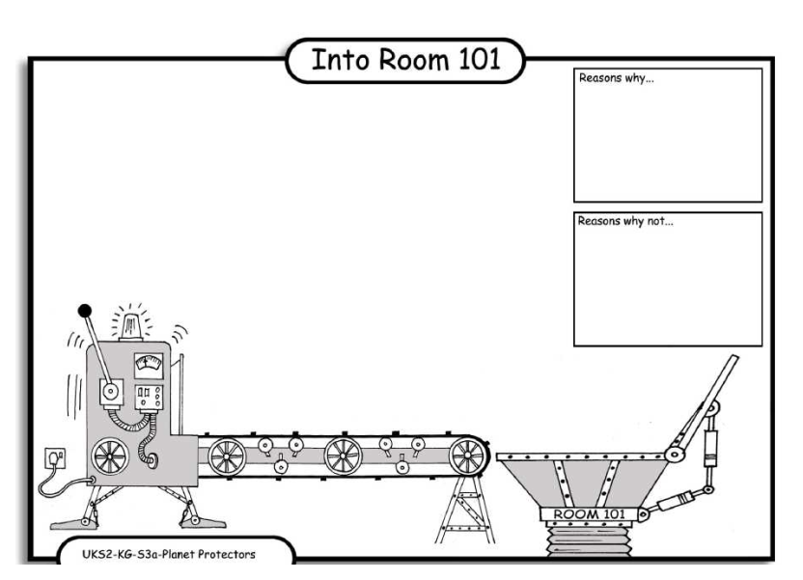
LO: Debating. 4.10.2013 Noah and Charlotte
Reasons Why:
If you put plastic bags into the Earth it will stay there for ever!!
Reasons why:
Plastic Bags can make people very ill.
Reasons why:
Its bad for little children because they will put it over there head.
Reasons Why:
You can slip over plastic Bags.

