Slide 1
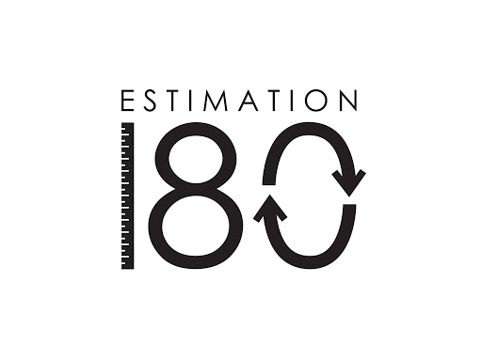
Starters
Today’s estimation.
https://estimation180.com/day-123/
You can get within 10g. Good luck.
Use Hit the Button to practise times tables and division skills.
https://www.topmarks.co.uk/maths-games/hit-the-button

Slide 2
Problems of the day

Slide 3
Answers to Problems of the Day

Slide 4
Today we will be looking at Drawing lines and angles accurately. You will find the video in SUMMER TERM –Week 10 (w/c 29th June). It is lesson 2. You will need a ruler and a protractor for this lesson. If you do not have a protractor, you can estimate the size of your angles if you wish.
https://whiterosemaths.com/homelearning/year-5/

