Slide 1
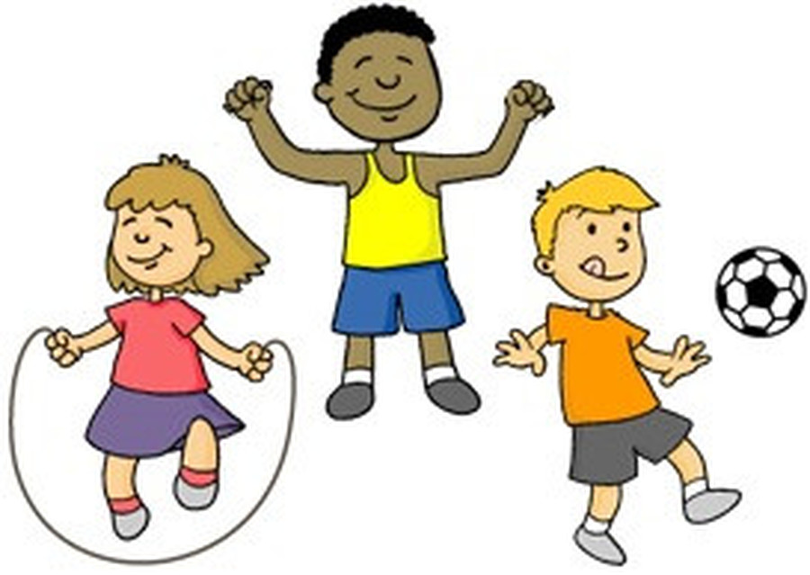
Connect 4
Jump on the spot x 30 | Perform a pencil roll | Perform 30 squats | Hold a seat balance for 30 secs | Perform 30 star jumps | Hopscotch for 60 secs | Pass an object around your head x 30
Design and draw a new sports kit in 60 secs | Run on spot with high knees for 30 secs | 60 secs to flip a bottle. Toss up in front of you | Stand on 1 leg and shut your eyes for 30 secs | Walk up and down a step x 30 | Perform 3 different jumps | Run and touch every door in your house/flat
Hop on right leg for 30 secs | Throw a ball against a wall x 30 | Balance an object on your head for 60 secs | Perform a safe forward roll on a cushion | Jump side to side for 30 secs | Keep an object in the air for 30 secs | Skip for 60 secs with or without a rope
Dribble a ball with your hand in and out of objects | Roll a ball out in front of you. Stop it with your bum! | Write on paper in 60 secs football teams in Premiership | Pass an object around your waist 30 times | Perform a figure of 8 around your legs with an object | How many kick ups can you do with a toilet roll? | Dribble a ball with your foot in and out of objects
Run /count the number of chairs in house/flat | Perform a plank for 60 secs | Run on the spot for 60 secs | Perform sit ups for 60 secs | Balance on 1 foot and 1 hand | Write on paper in 60 secs women sports stars | Perform 30 press ups
Do 30 arm circles with both arms | Perform hip circles for 60 secs | Perform a 60 sec dance routine | Touch your toes and jump up x30 | Hop on left leg for 30 secs | Perform 30 squat jumps | Jump over 3 cushions X 30 secs

Slide 2
ACTIVE CONNECT 4
This is a 2 player game.
The first player to complete 4 activities in a row wins.
The player has to complete the activity before moving to the next activity.
Draw a grid like the one below on paper to mark off where you have been.

