Slide 1
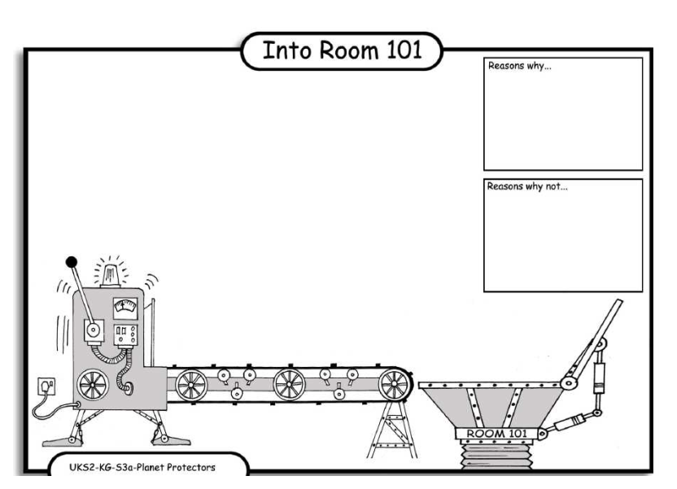
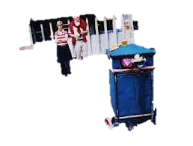
LO: Debating. 4.10.2013 Kuzdaishe and Bailey
Reasons why:
The litter smells nasty.
Reasons why:
Cause there is rubish in the difrnt cuntreys some of the anmals are getting hert .
Reasons why:
And if there was no rubish the world would be clen and have fresh.
Reasons why:
THE RUBISHE can make the rats cause dsise.

