Slide 1
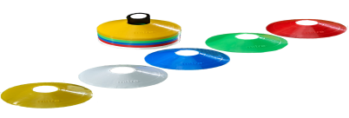
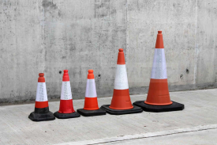
Primary at home challenges
KS2
GAMES 3: KING OR QUEEN OF CONES GAME
Equipment needed: 5 small cones, non breakable toys or toilet rolls plus 2 balls or 2 pairs of rolled up socks.
1. Set up a line of cones/toys/toilet rolls opposite your opponent at any distance apart. Stand behind them.
2. Aim your ball/socks at your opponents line. If you hit one of their cones, run out to remove it and add it to your line. The
winner is the one who collects all the cones.
3. How are you aiming at the cones? Right or left handed throw? Underarm or overarm throw?
4. Arrange your cones in a different pattern (V shaped, rainbow shape etc.) or use different size toys. Play again!
GOOD LUCK!
Can you challenge all your family members?

