Slide 1
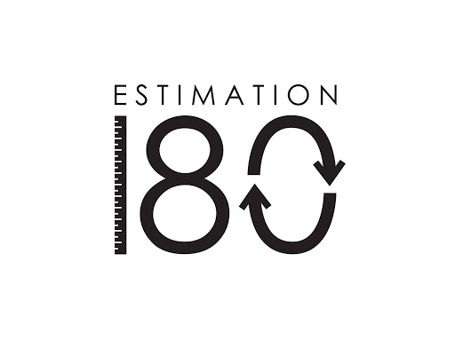
Starters
Today’s estimation.
https://estimation180.com/day-122/
Estimating the amount of mini eggs today. You can get within 10. Good luck.
Use Hit the Button to practise times tables and division skills.
https://www.topmarks.co.uk/maths-games/hit-the-button

Slide 2
Problems of the day

Slide 3
Answers to Problems of the Day

Slide 4
Today we will be looking Measure with a protractor. You will find the video in SUMMER TERM –Week 10 (w/c 29th June). It is lesson 1. You do not need a protractor for all of the questions but you will need one for question 5. If you don’t have one you can still estimate for this question. Other questions ask you to estimate some of the angles.
https://whiterosemaths.com/homelearning/year-5/

